Slide 1


A HISTORY OF BLACKSMITHING
Gaspar Lesznik
Artist - Blacksmith - Engineer
AU 2019

Slide 2
Disclaimer
I don’t shoe horses.
Farriers shoe horses.
All Farriers are Blacksmiths.
Not all Blacksmiths are Farriers.

Slide 3
Blacksmith = black + smith
Steel, or iron, creates a black layer of scale (iron oxide) when heated and exposed to oxygen. Also, hot steel is often coated with oil to help protect it from corrosion. This further blackens the metal.
From the Old English word “smythe” which means “to strike”.
smith
From the proto-Germanic word “smithaz” which means “skilled worker”.
A blacksmith makes tools and other objects out of metal by heating it and using force to bend, twist and otherwise shape the material.

Slide 4
Blacksmiths and the Gods
Vulcan, son of Jupiter (Roman)
Hephaestus, son Zeus (Greek)
Sethlans, fire god of smithing and crafts (Etruscan)
Ptah, patron god of craftsmen and smiths (ancient Egypt)
Ikenga, spirit of success and blacksmiths (Igbo - ancient Nigerian)
Ogun, patron of blacksmiths (Yoruba – African religion)
Qaynan, patron god of smiths (Sabaean people of pre-Islamic Arabia)
Ribhus (Hindu)
Brigid, goddess of blacksmithing (Celtic)
Gofannon, god of blacksmithing and ale (Welsh)
Kothar-wa-Khasis, patron got of metalworking (Ugaritic)
Tlepsh, god of smithing (Circassian)
Ilmarinen, god of blacksmithing (Finnish)
Hadur, god of metalworking and war (Hungarian)
Brokkr, one who works with metal fragments (Nordic)
Kudalaegon, god of blacksmiths (Ossetian)
Svarog, god of the forge (Slavic)
Kagu-tsuchi, patron god of blacksmiths (Japanese)
Ba Kim, goddess of metal and blacksmithing (Viet Nam)
Goibniu god of blacksmithing (Irish)

Slide 5
Stone Age
200,000 BP 5,000 BC 4,000 BC 3,000 BC
Pre-history
Early man tames fire
Wheel
Simple machines
Prehistoric art
Stone Tools
Agriculture
Early writing
Copper usage
Domestication of animals
Earliest iron artifacts
Ornamental Beads
Meteor iron-nickel
Copper smelting
Metalsmithing emerges
Cold working with stone and bone tools
Soft elements
Gold
Silver
Copper
Lead

Slide 6
Fun Facts !!
Fun Facts !!
Fun Facts !!
Melting points of common metals:
Tin 449.5 F
Lead 621.4 F
Silver 1,763.2 F
Gold 1,947.5 F
Copper 1,984.3 F
Iron 2,800.0 F 500 BC
4,000 BC

Slide 7
Bronze Age
3,500 BC 2,000 BC 1,500 BC
Smelting of copper and tin to produce bronze developed in separate global regions at different times.
Bronze tools, weapons, armor, ornaments, bowls, containers, urns, other.
Iron making technology starts to emerge.
Hittite Empire
Mesopotamia,
Ancient Greece,
Babylonia
British Isles,
Asia
China

Slide 8
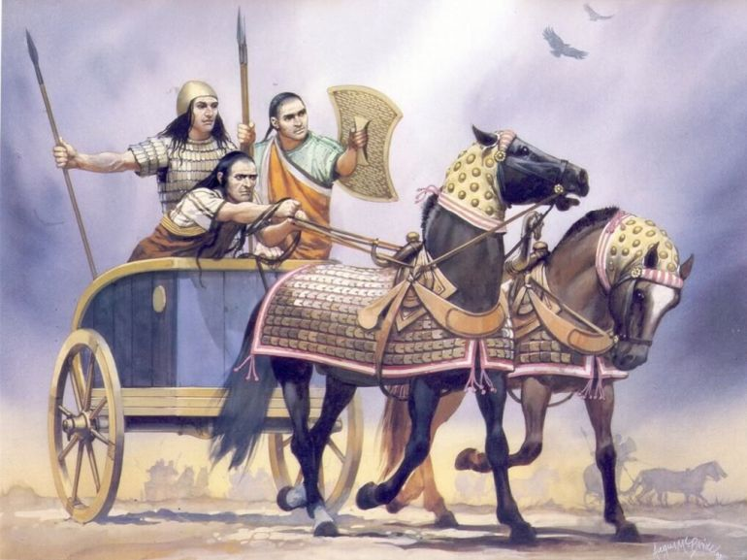
The Hittites ~ 1,500 BC
A warlike people occupying Anatolia in modern day Turkey developed technology to smelt iron ores.
Their weapons, tools, and chariots were far superior to anything available at the time.
Their iron works are believed to be the first in the region and they had a monopoly on these products, which can be found in archaeological digs.
Their knowledge was closely held for the next 300 years allowing them to dominate the region (~1,500 – 1,200 BC).

Slide 9



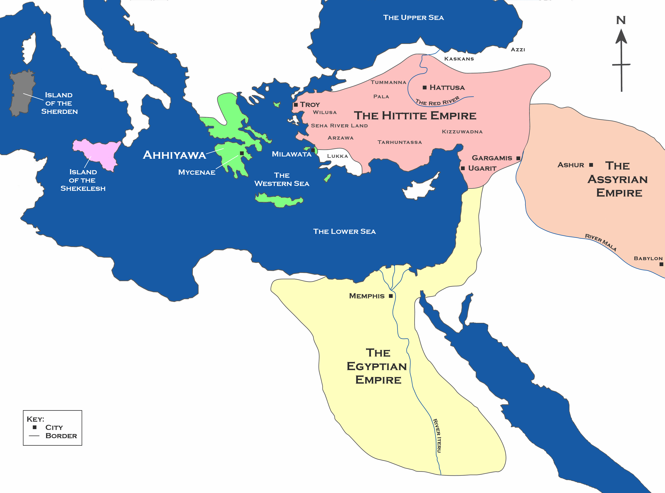
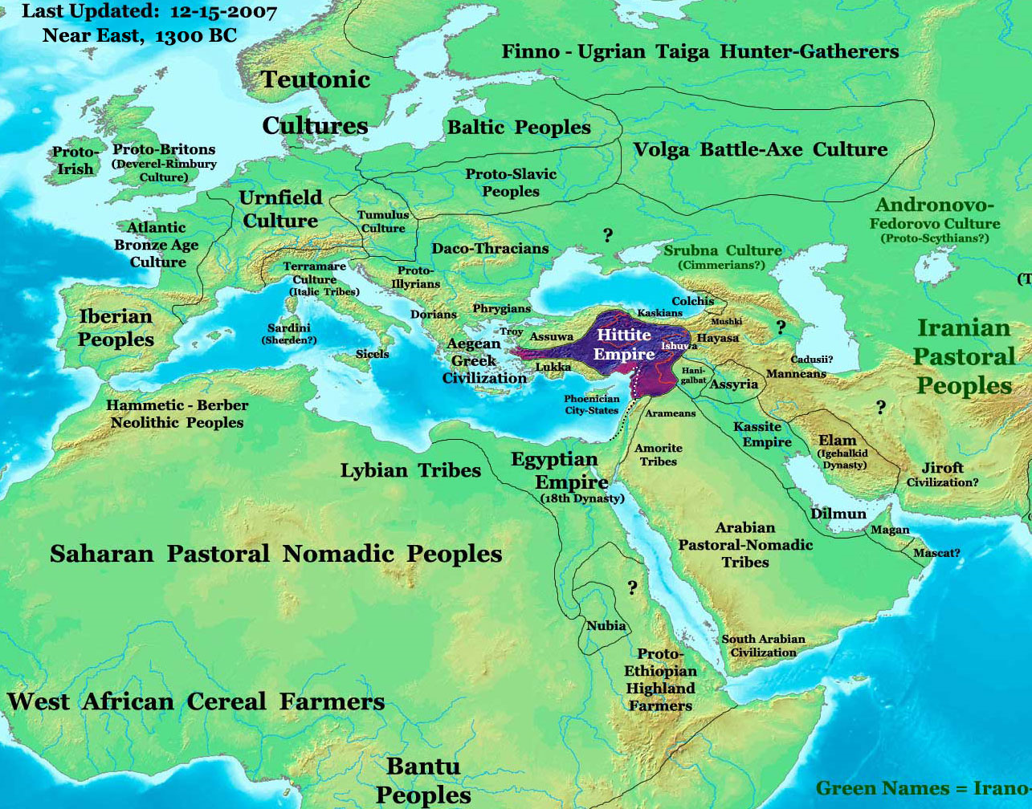
Hittite Empire

Slide 10
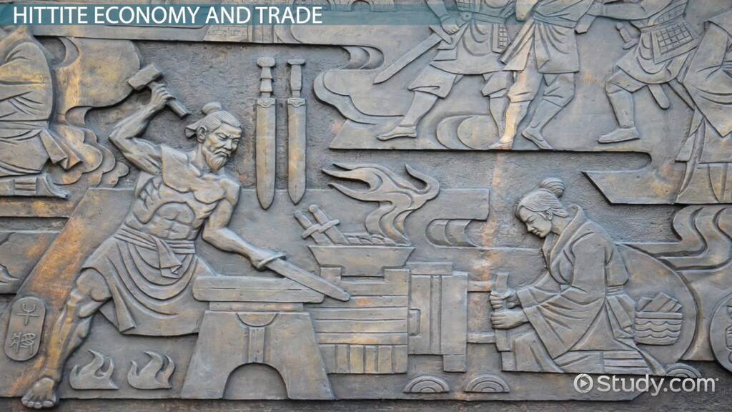
A Hittite Blacksmith

Slide 11
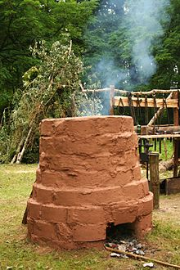
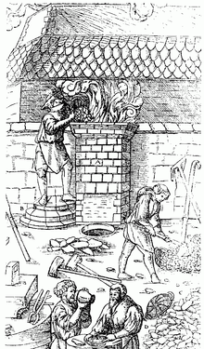
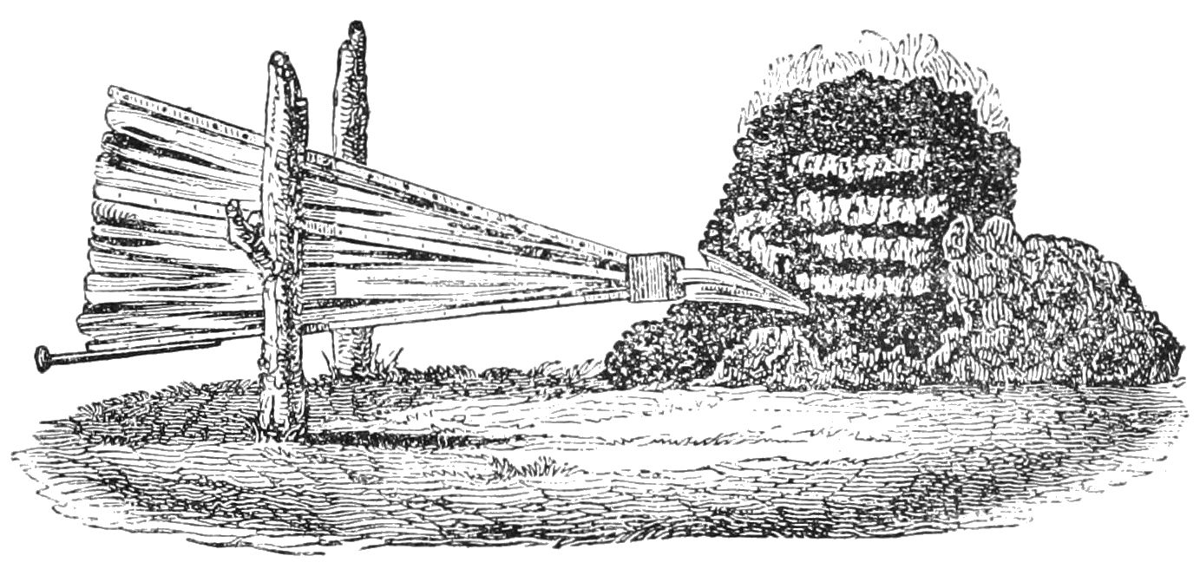
How did they do it?
The Bloomery furnace:
Metallurgical furnace used to smelt iron ore.
Produced a mass of iron and slag called a bloom, or sponge iron.
Long, arduous process. The bloom was reheated multiple times to separate impurities.
Blacksmiths hammered the mass creating a block of wrought iron.

Slide 12
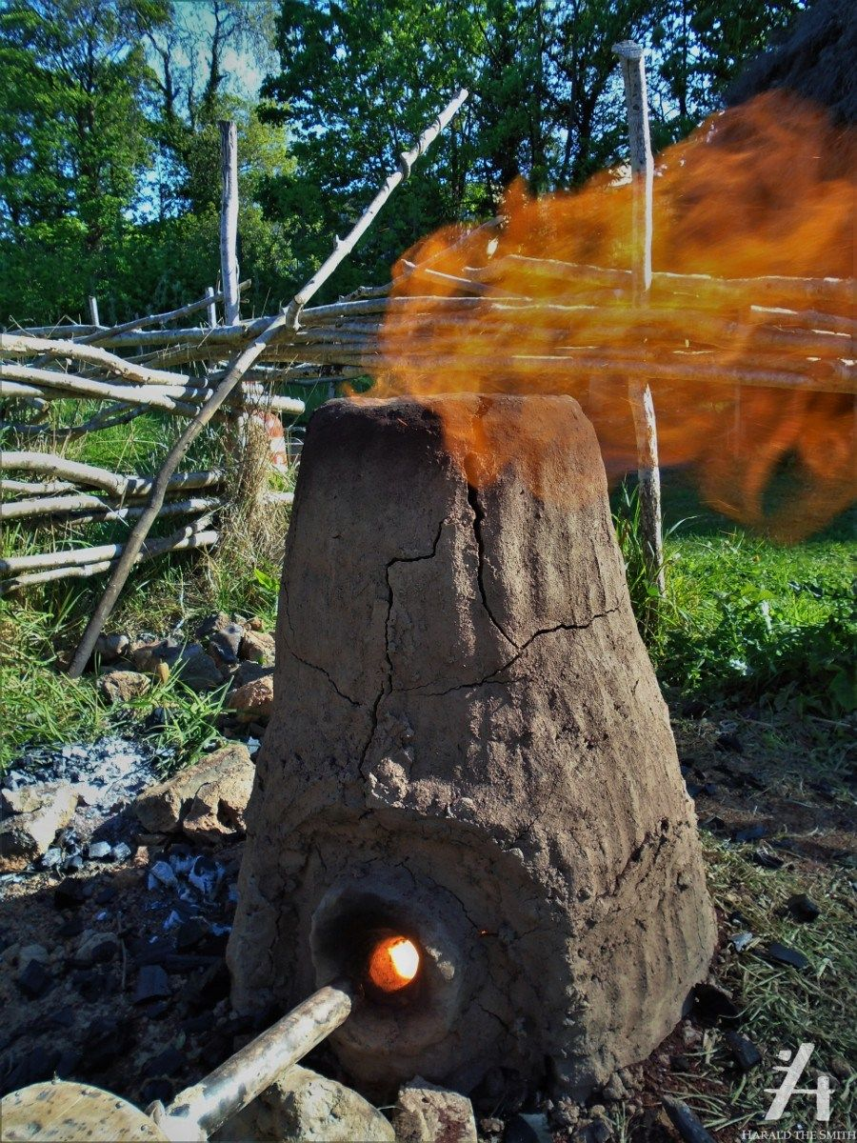
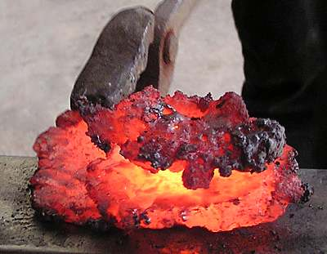
An Iron Bloom

Slide 13
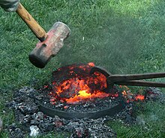
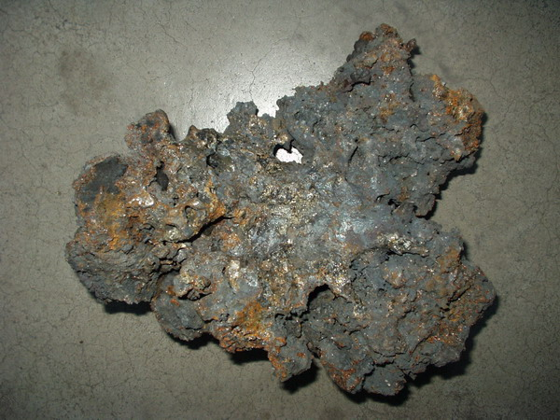
An Iron Bloom

Slide 14
Iron Age Emerges
1,500 BC 1,200 BC 1,000 BC
Hittites control iron technology and the market for iron.
Production could not meet demand.
Hittite empire starts to decline.
Drought
Earthquakes
Famine
Invasion from neighboring peoples.
Hittite people migrate into the Mediterranean, Asia Minor.
Iron producing technology spreads.
Daily life, farming, pottery, metalworking continued but on a smaller scale.
Iron production (wrought iron) well established throughout Europe, Asia and sub-Sahara Africa.
Also, China and India but evolved separately.
Roman and Greek empires start to emerge.
Blacksmiths thrive.
Iron Age fully established.

Slide 15
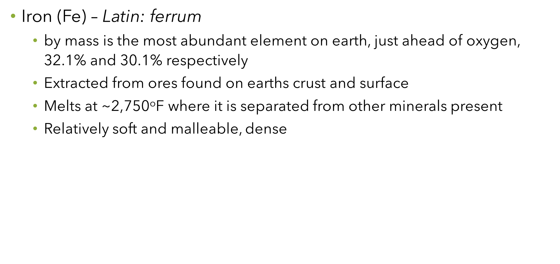
Fun Fact !!
Fun Fact !!
Fun Fact !!

Slide 16
Forging and Temperature
Forging is the act of shaping metal with kinetic energy (tools and muscle)
Heating steel to above it’s critical temperature (~1,350ºF) changes the crystalline structure of steel making it malleable. A plastic state called austenite. Non-magnetic.
Forging is typically done between 1,650ºF to 1,975ºF
Blacksmiths produce objects such as weapons, gates, grilles, railings, light fixtures, furniture, chain, sculpture, tools, agricultural implements, decorative and religious items, cooking utensils, and more weapons, and much more.

Slide 17
Blacksmith Equipment - the Forge
Hearth or forge to heat metal.
Target high temperature from 1,700º to 2,300ºF.
Originally constructed of brick and mortar. Today cast iron, steel, brick and mortar.
Must have forced air (oxygen). Bellows, blower, fan, ...
Fuel
Originally wood, charcoal.
Today coal. Widely available. Efficient and inexpensive.
Propane
Delivery of air (oxygen) is essential for a hot fire

Slide 18
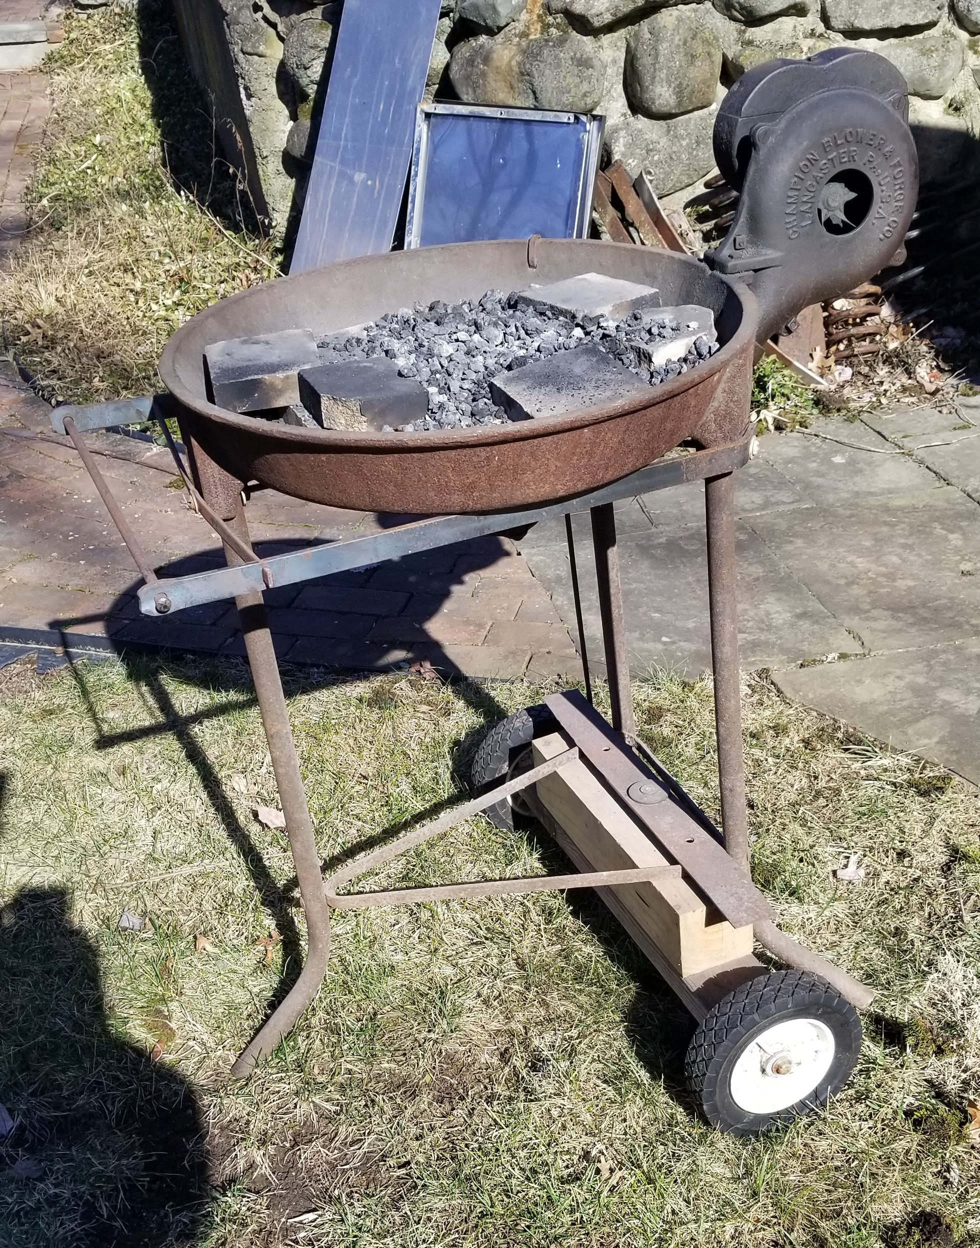
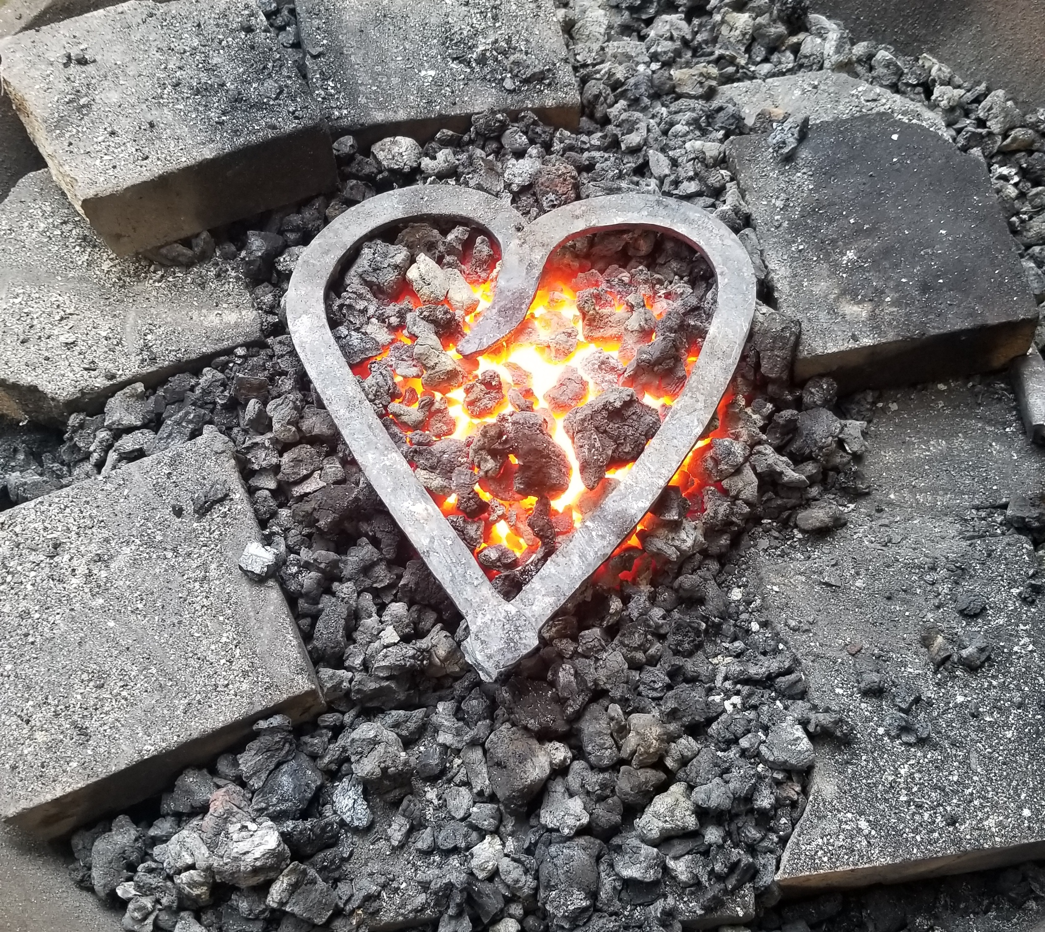
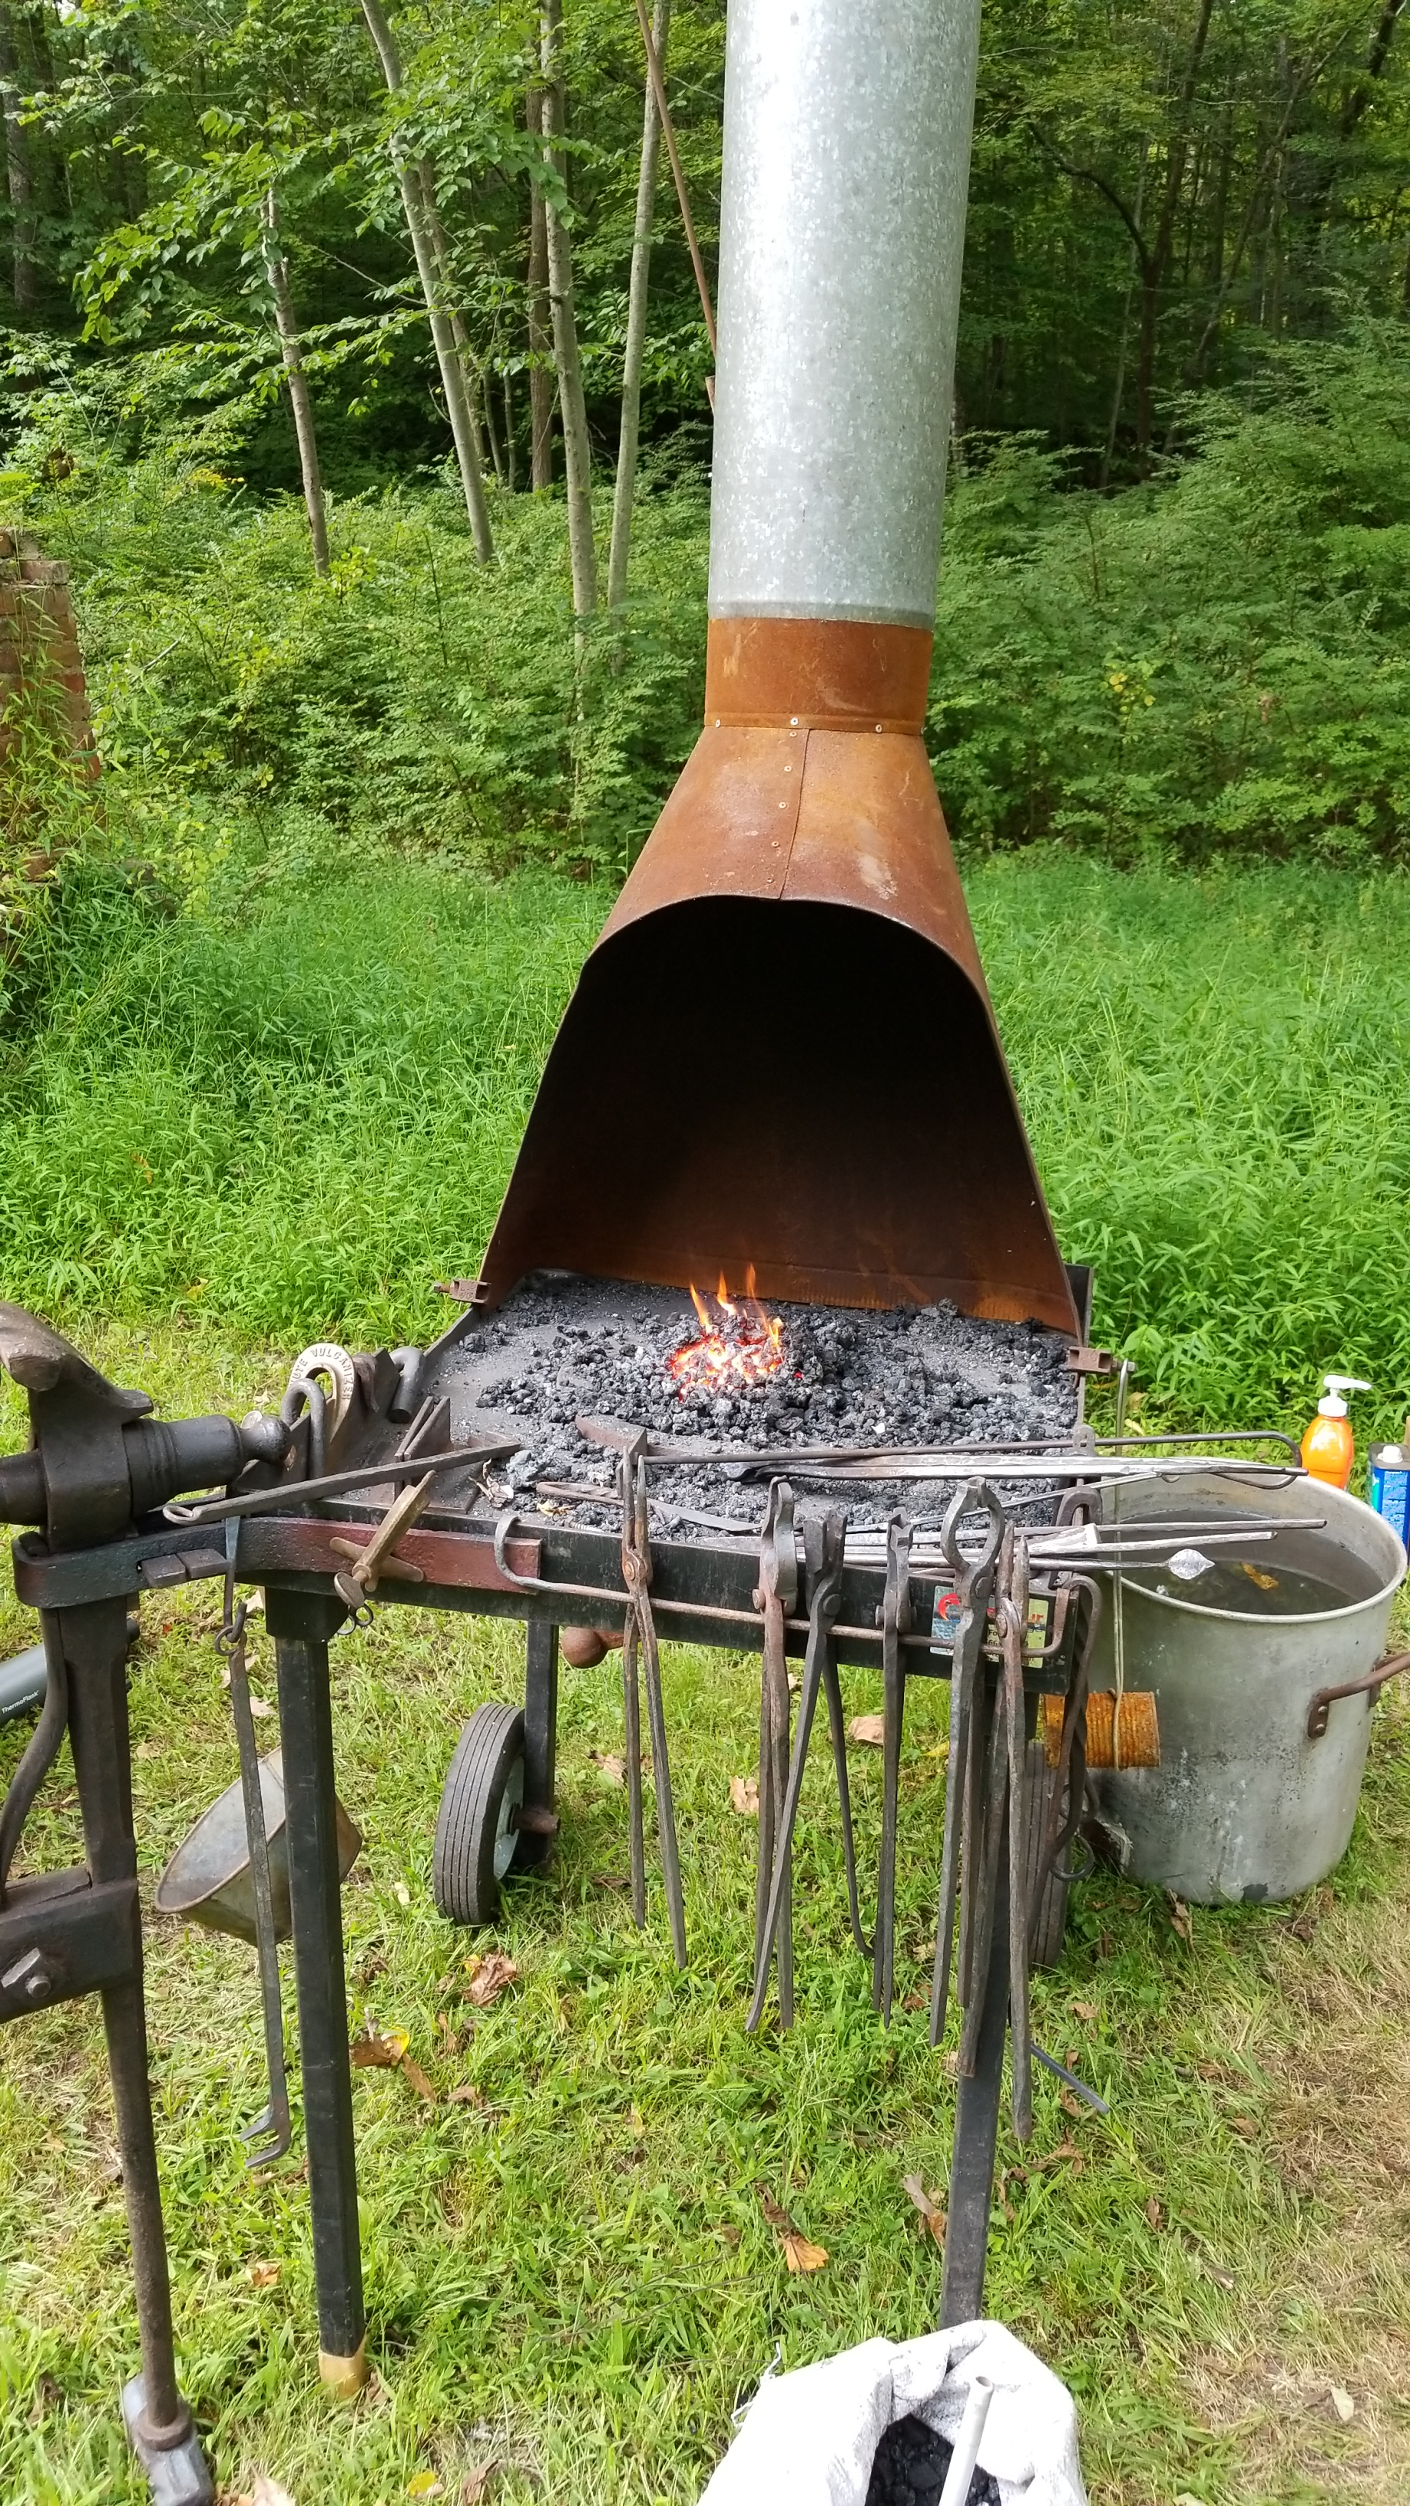

Slide 19
Blacksmith Equipment – the Anvil
Anvil (the soul of the smithy)
Acts as a mold, platform and third hand to shape the metal.
Accepts various tooling for cutting, twisting, holding, etc.
Must have mass.
Any heavy metal block can work to degree.
Accessories
Vice, quench bucket(s), hammers, tongs, punches, chisels, hand tools

Slide 20
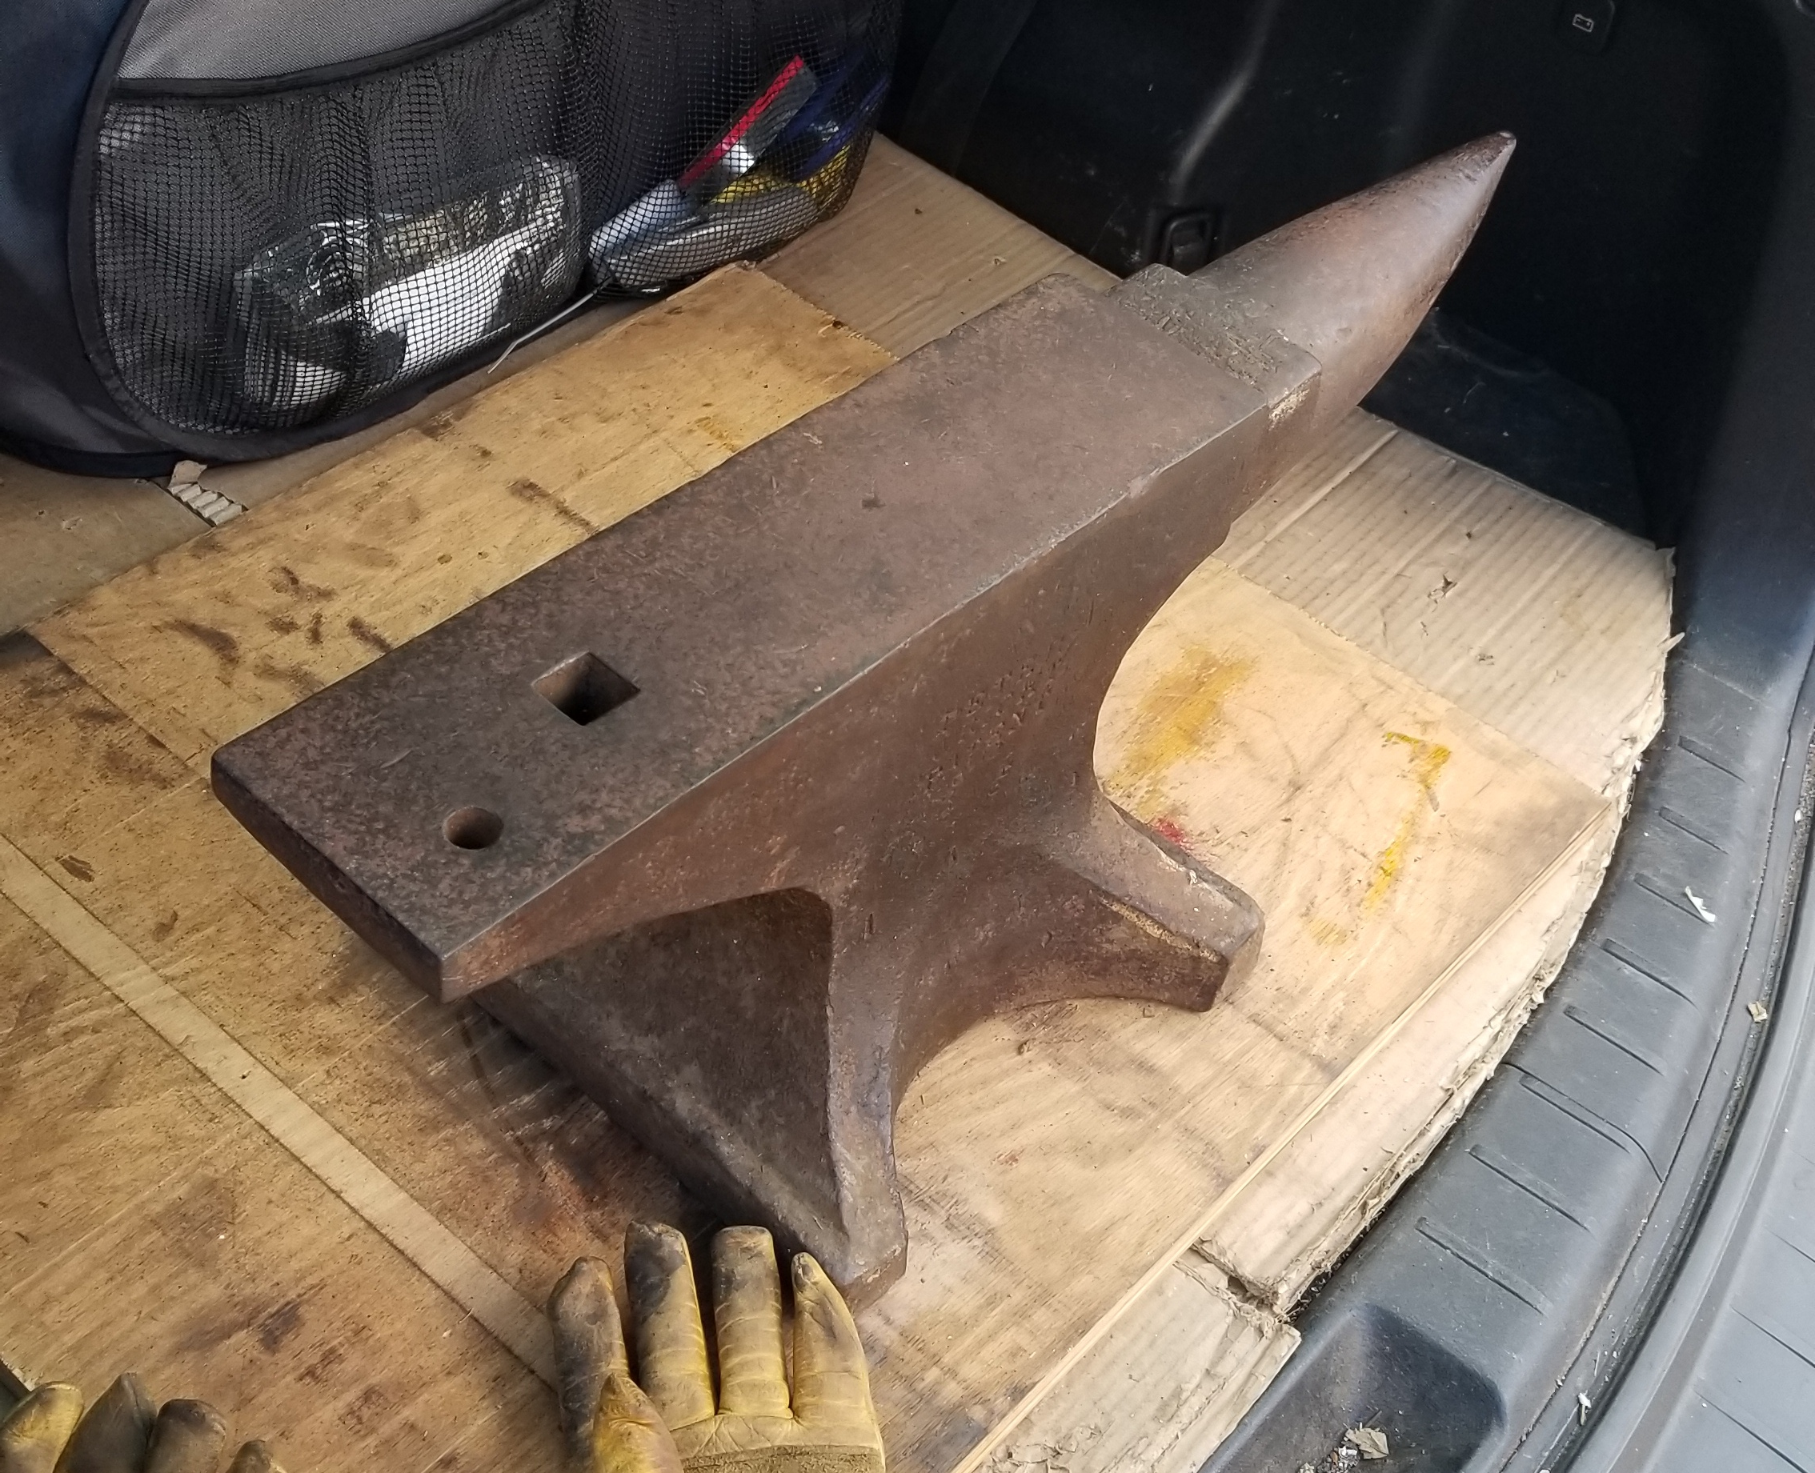
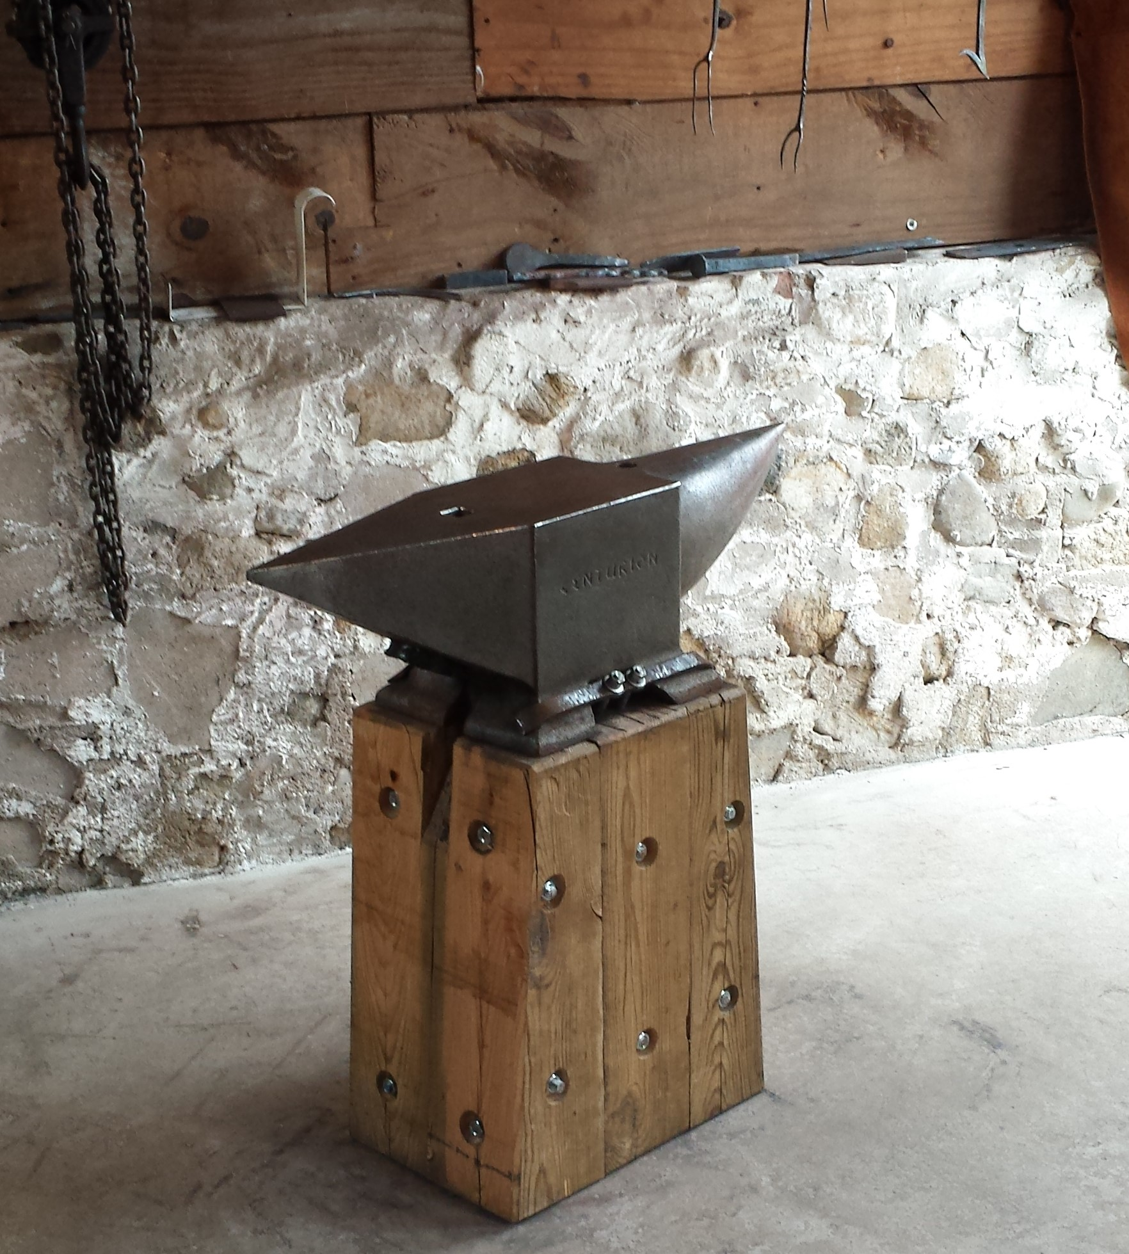
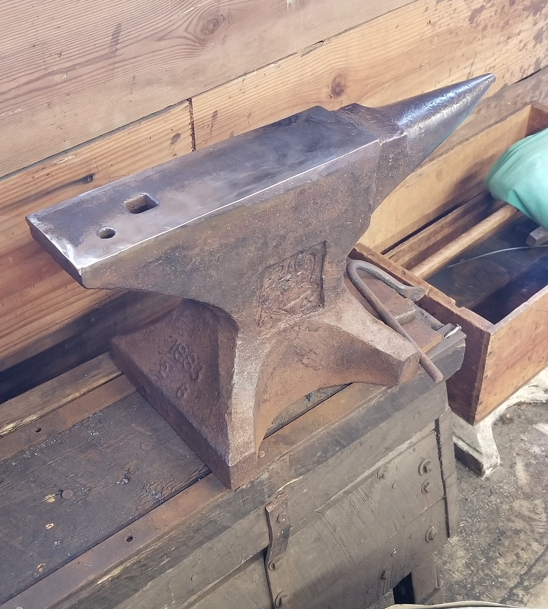
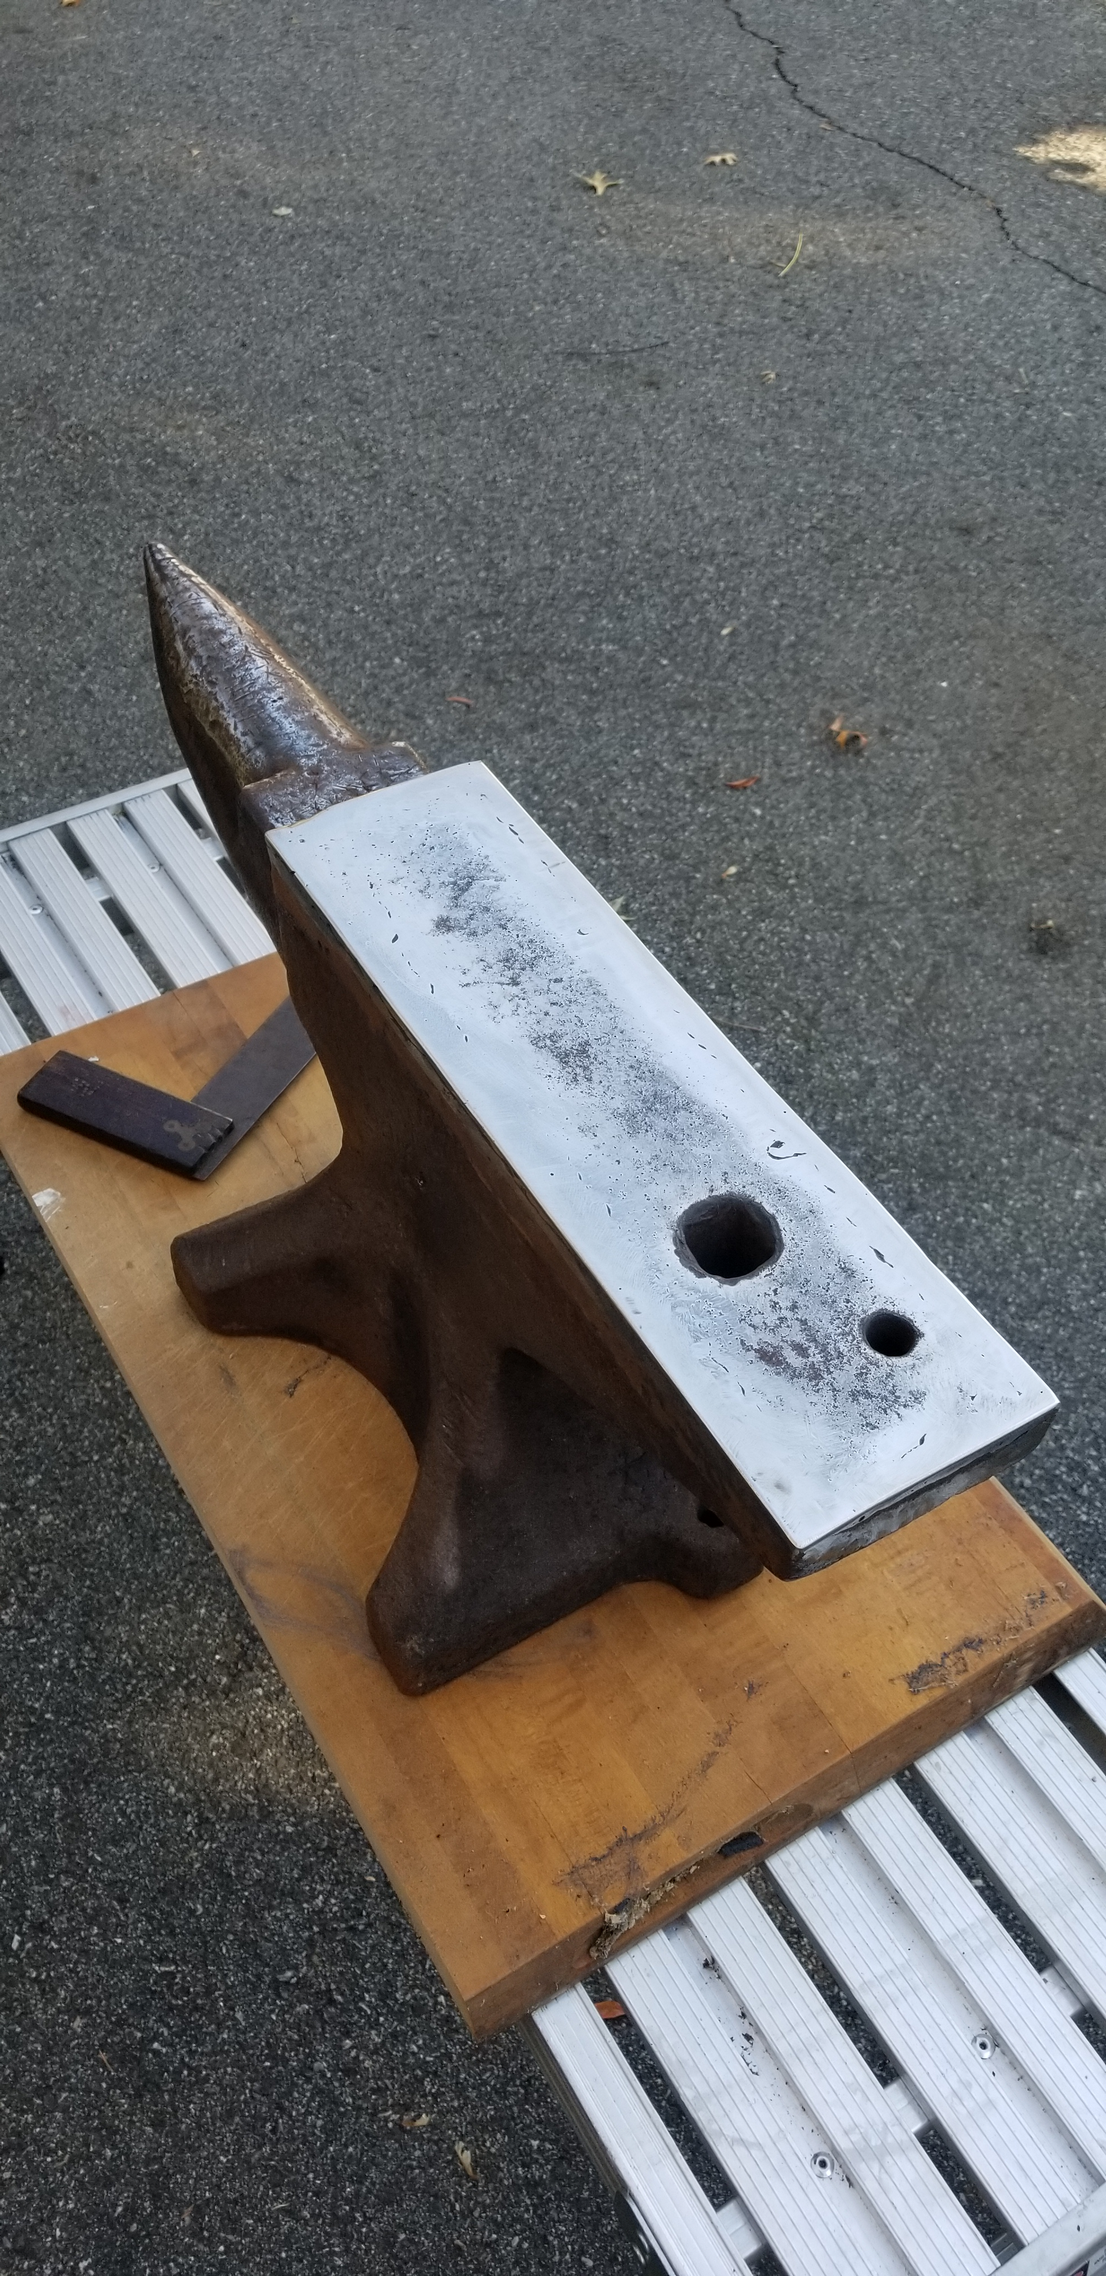

Slide 21
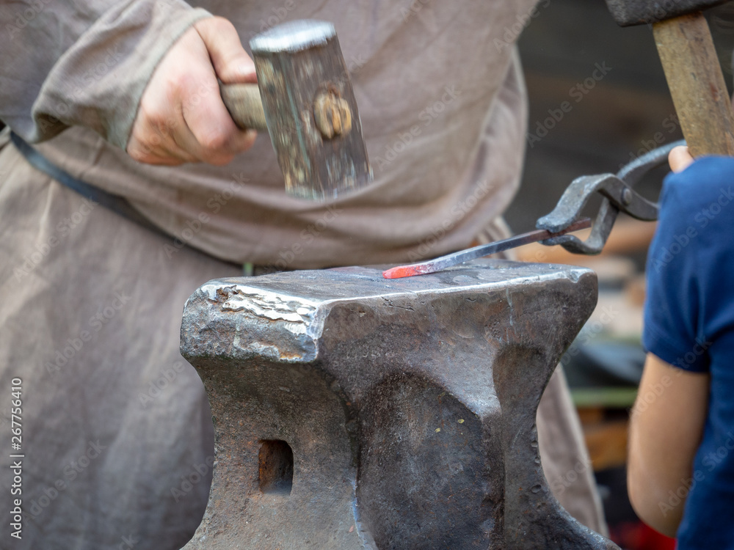

Slide 22
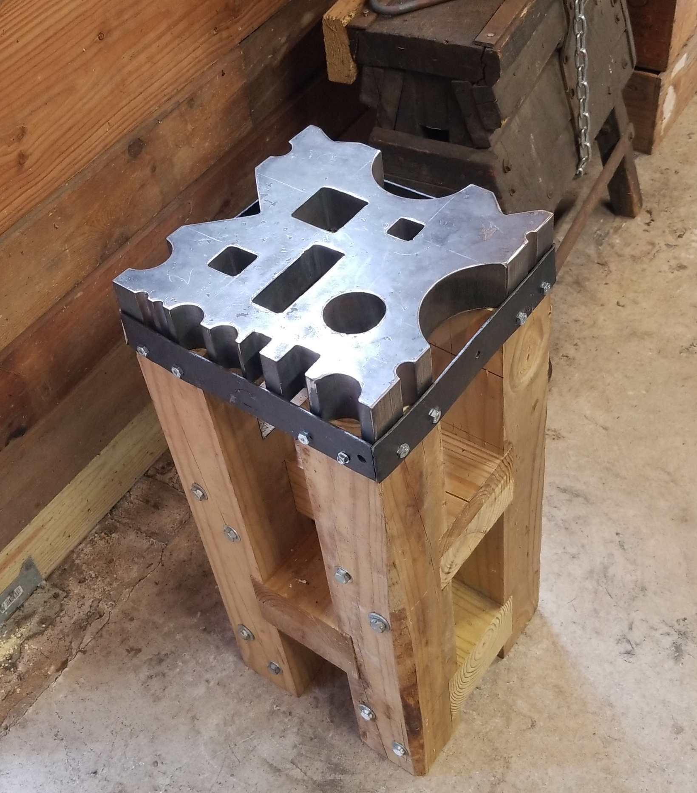
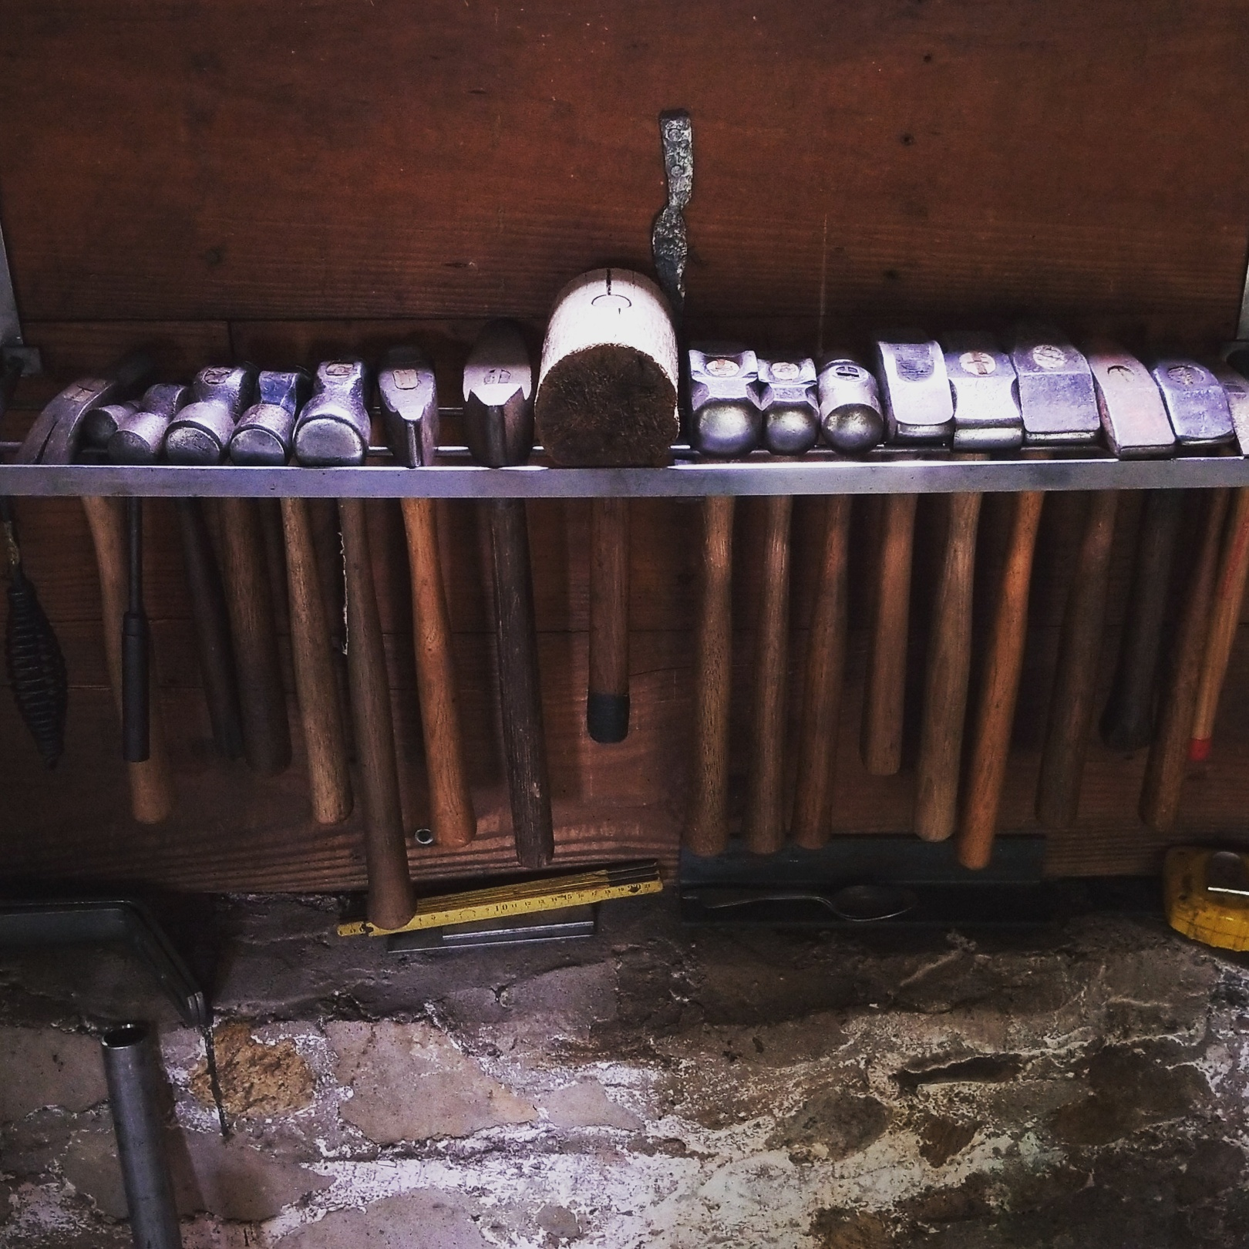
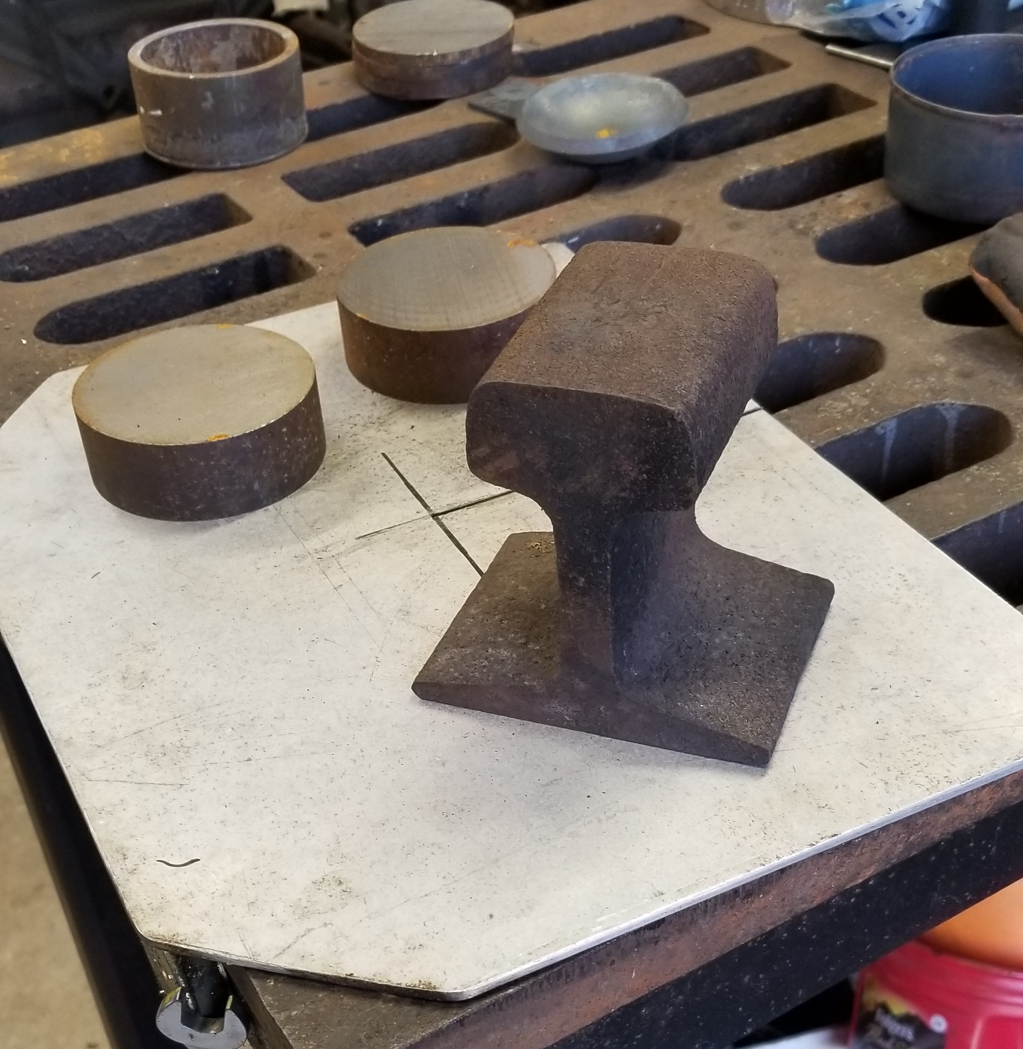
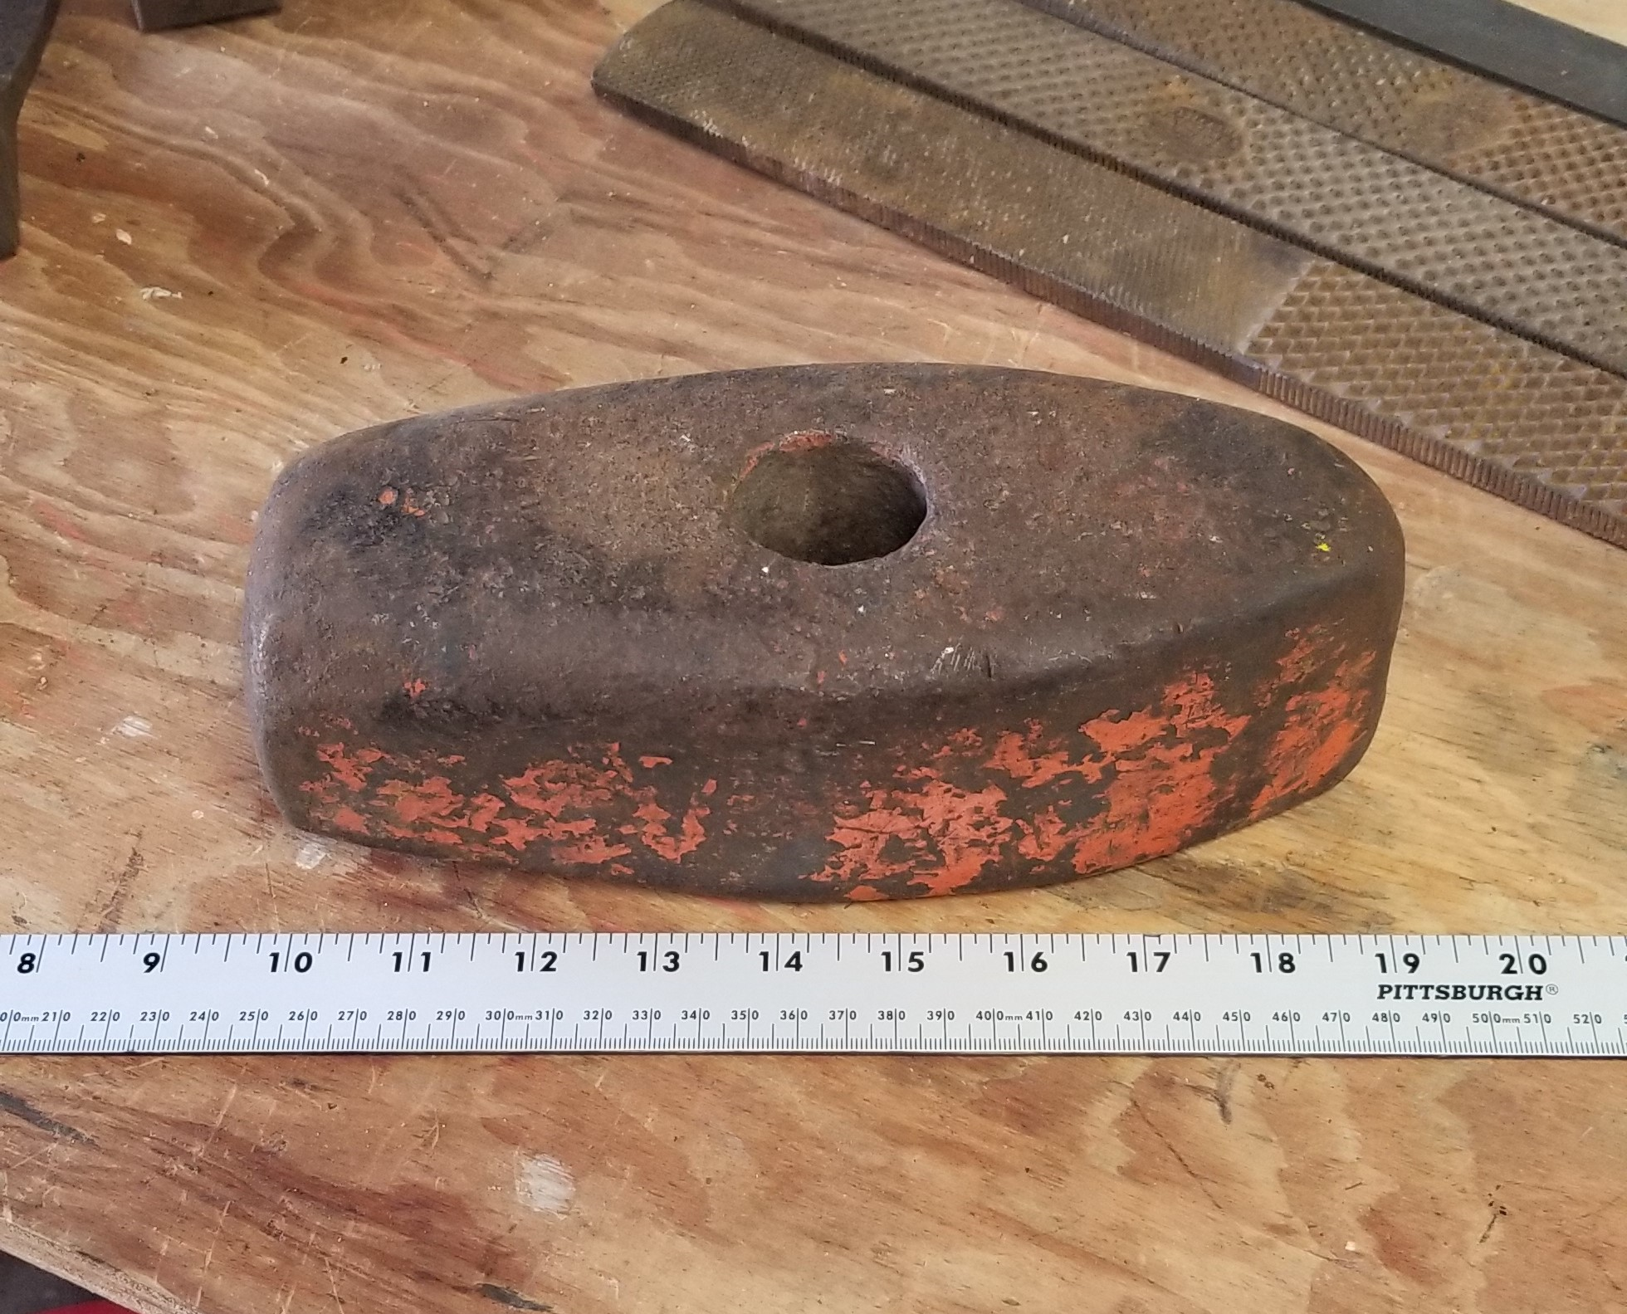

Slide 23
Notable Ancient Blacksmithing Events
1,000 BC 500 BC 400 BC 100 BC
Wrought iron production well known and spreading.
Ancient Roman and Greek empires start to emerge.
Smiths in Europe start making wrought iron from pig iron using finery forges fed with charcoal.
Evidence of cast iron in China.
India exporting wootz steel to China, Africa, Europe, Middle East.
Roman empire subjugates the Greeks ~146 BC.

Slide 24
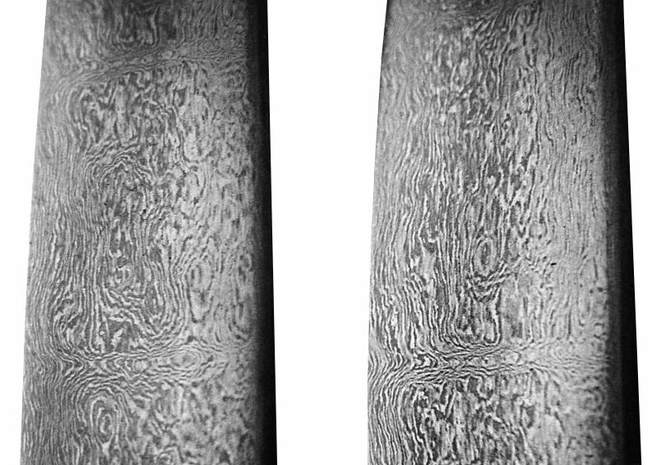
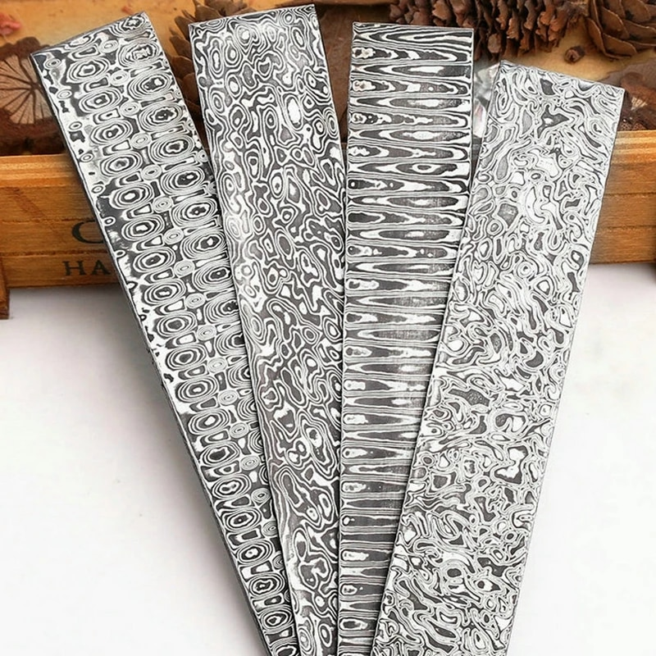
Wootz Steel and Damascus Blades

Slide 25
Blacksmithing Thrives During Historic Eras
100 BC 100 AD 500 AD 1,000 AD 1,500 AD 1,900 AD
Silk Road Trade Routes
Roman Empire
Middle Ages
Crusades
Mongol Empire
Ottoman Empire
America
Civil War

Slide 26
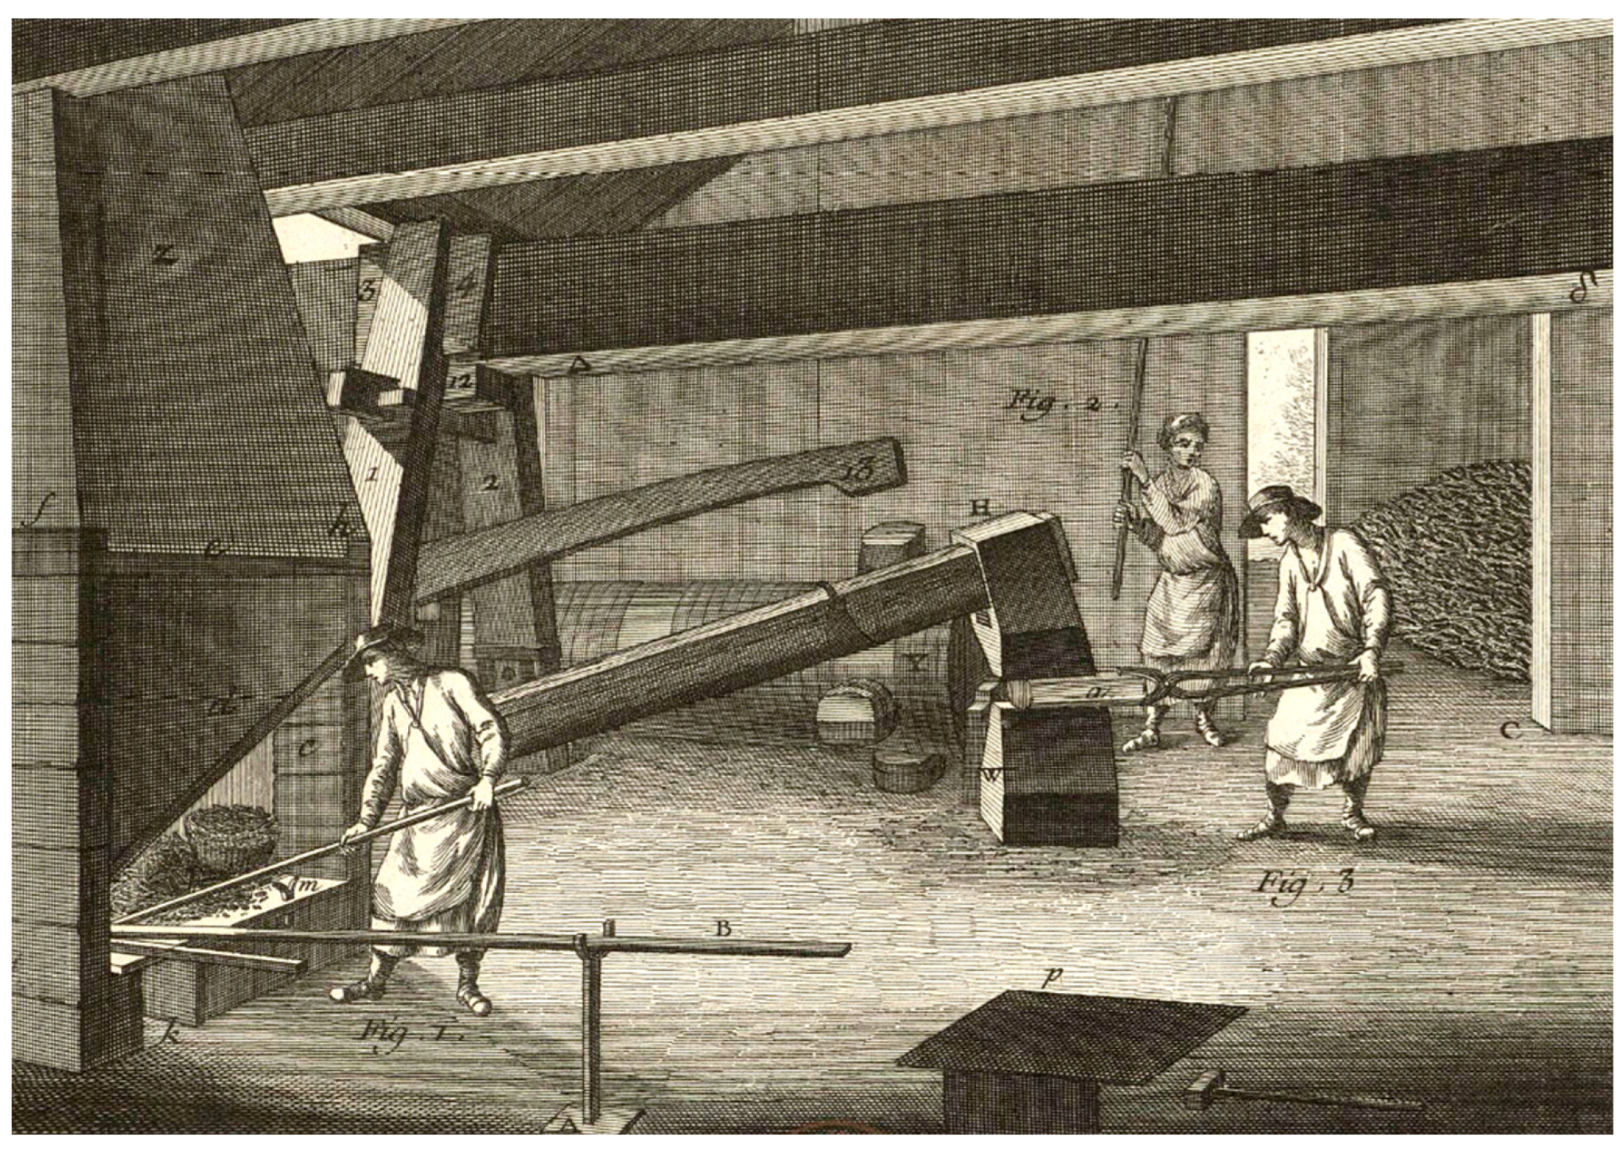
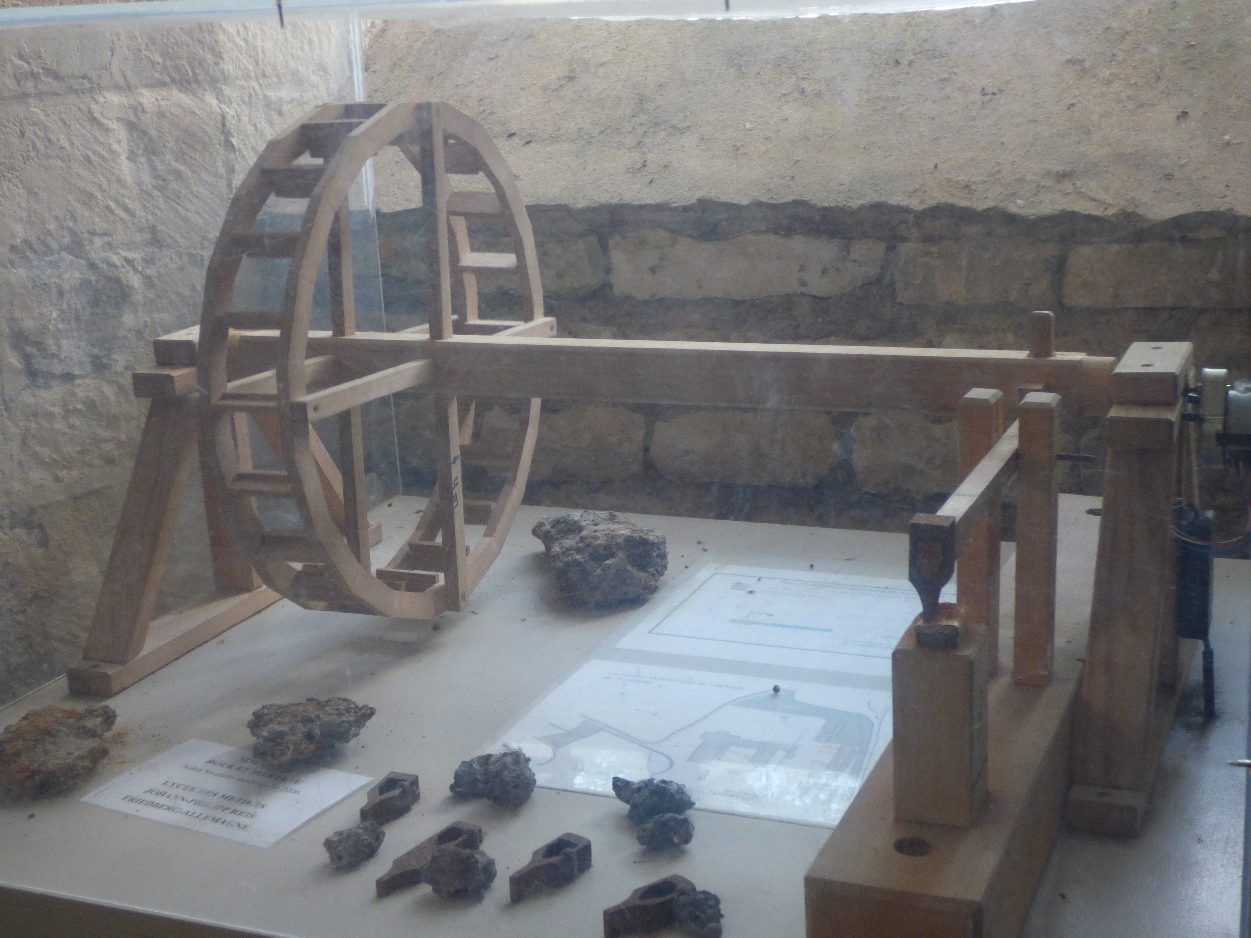
Middle Ages
Water Wheel Trip Hammer

Slide 27
Viking Age
~793 to ~1066 AD
Mastermyr chest, circa 1000 AD found in Sweden
Over 200 blacksmith tools and works in progress
Largest find of tools in Europe from that period
Chain, hammers, small anvils, snips, lock parts
Many of the tools resemble those from early Roman age

Slide 28
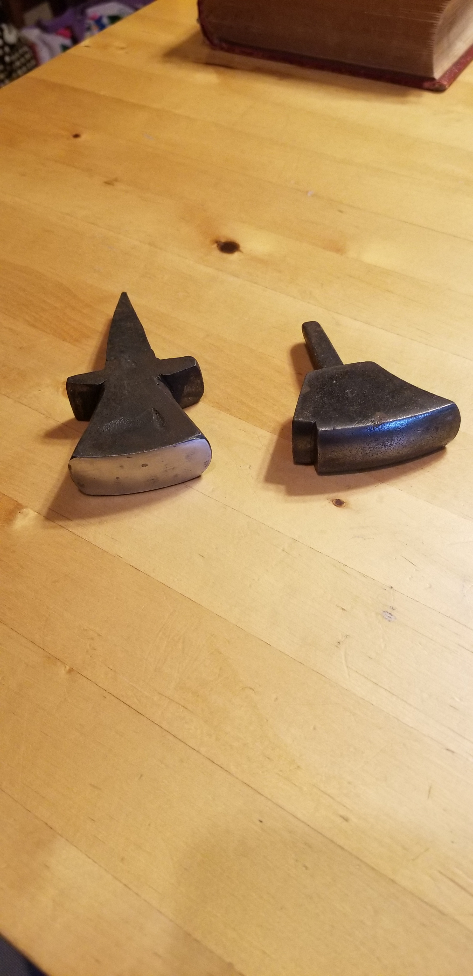
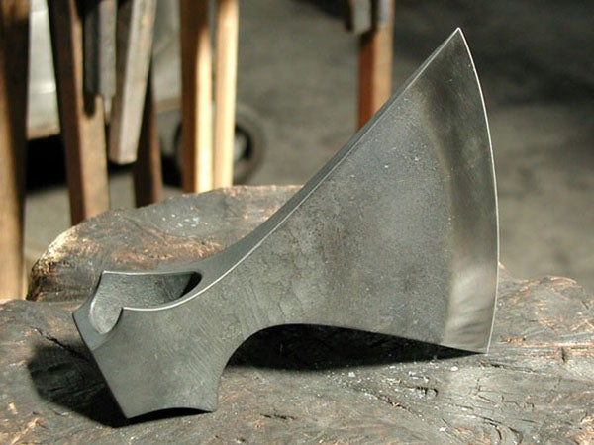
Viking Age

Slide 29
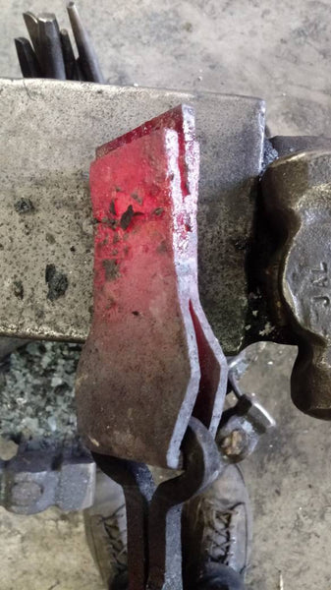
Forge Welded Axe Head
Tool steel blank
Mild steel body

Slide 30
Fun Fact !!
Steel = Fe (~99%) + C (~<1%)
Mild (Low Carbon) Steel: C = < 0.25%
Inexpensive, the most abundant steel used globally (~90%). It is used in everything that does not require superior strength or durability.
Can not be hardened. Can not hold a sharp edge.
Piping, fencing, ornamental, wide range of structural applications (bridges)….
Medium Carbon Steel: C = 0.25 – 0.55%
Can be hardened.
Railroad tracks, machinery parts, pressure vessels, cranks…..
High Carbon Steel: C = 0.55 – 0.99%
Maximum strength and hardness, low ductility.
Knives, chisels, punches, spring steel, cutters, ………

Slide 31
Wrought Iron
An iron alloy with <0.02% carbon and ~2% other impurities (slag)
Used throughout history but replaced by advanced steelmaking methods
No longer commercially available, last foundries shut down in the 1970’s

Slide 32
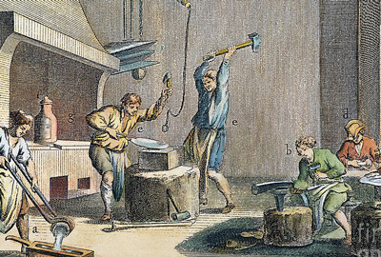
Colonial Period Blacksmith Shop

Slide 33
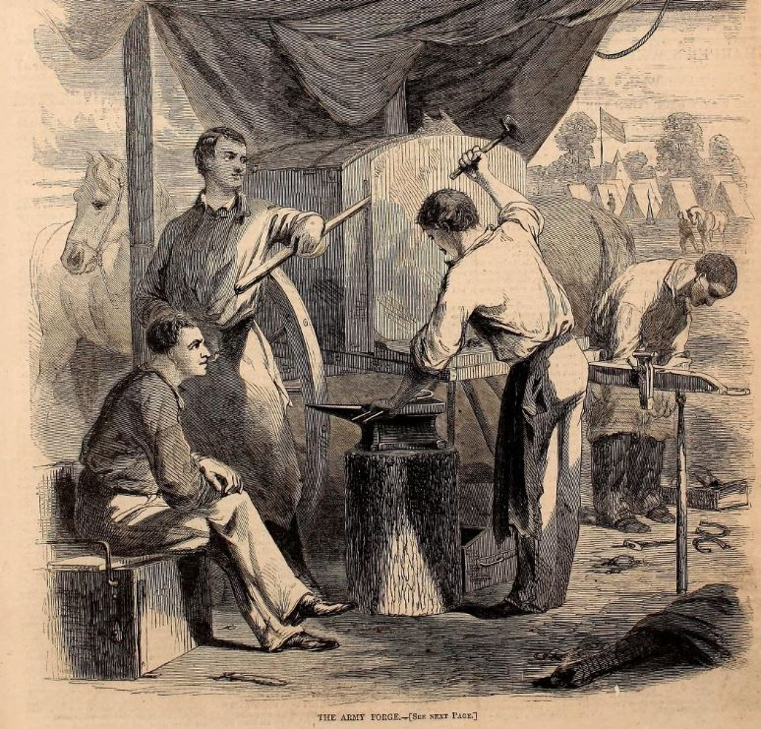
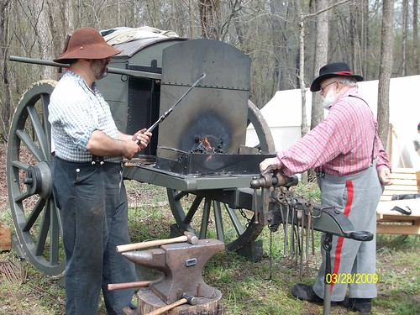
Civil War Traveling Smithy

Slide 34
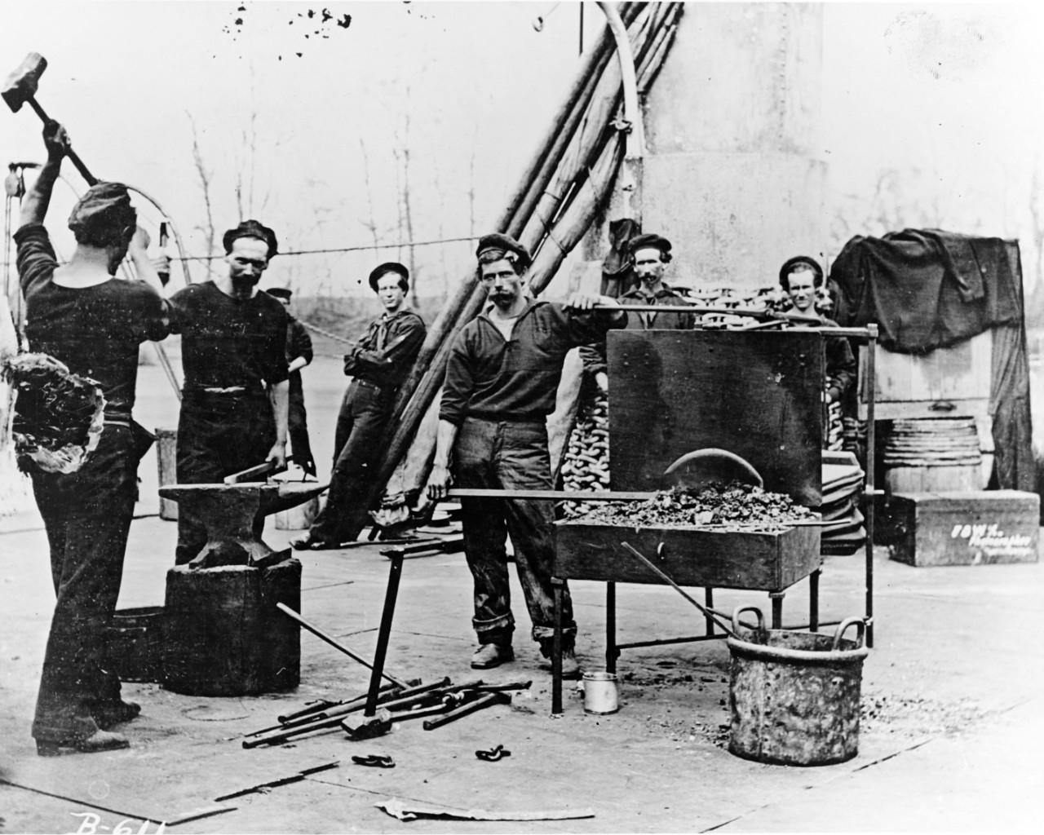
Navy - Civil War
Blacksmiths on deck of USS Leigh, a Passaic class monitor ship.

Slide 35
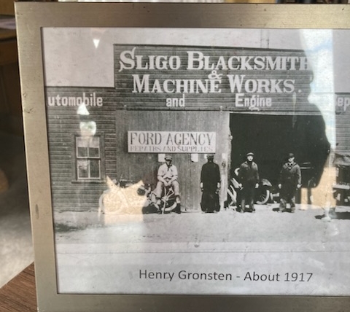
Evolution – post Industrial Revolution
Ironworkers
Mechanics
Pipe-fitting
Other

Slide 36
Ludlow & Squire
Newark, NJ
Industrial Supply Catalogue
©1919
15 pages dedicated to blacksmith tools

Slide 37
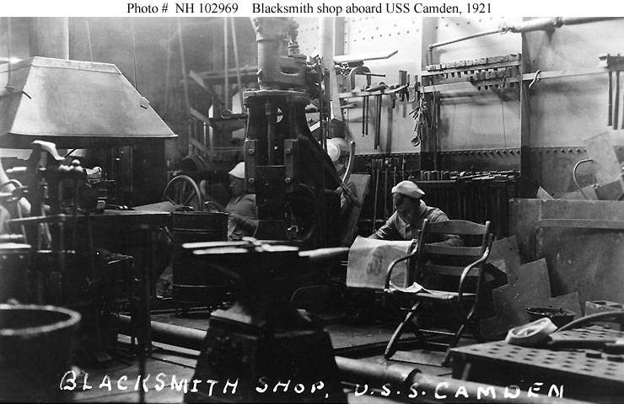
Navy

Slide 38
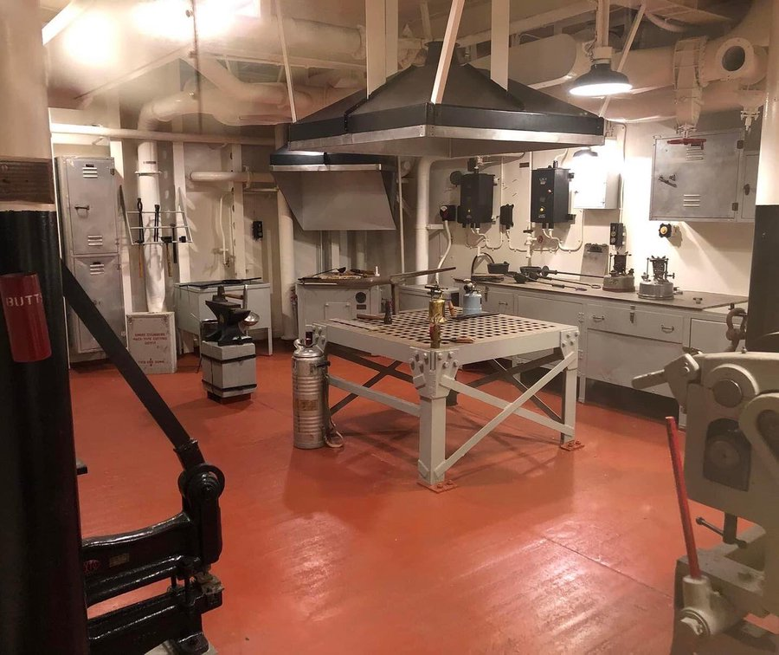
Navy - WWII
USS Alabama
Full blacksmith shop

Slide 39
Blacksmithing Today
Alive and well
Artistic and ornamental, repair and restoration, farriers
ABANA - 5,000+ members (US)
Most states have a club or association
U-tube - hundreds of channels
Anvil and other accessory manufacturing is growing
Anvils average $7.50 to $9.00 / lb.
Fun Fact !!

Slide 40
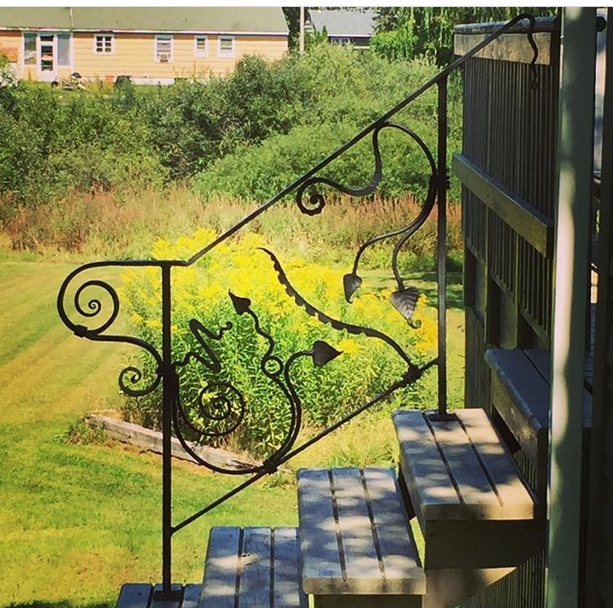
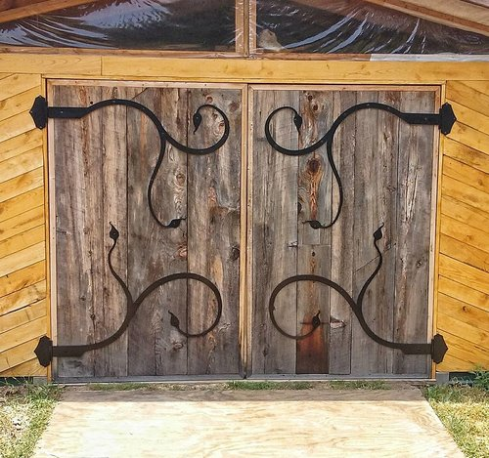
Sculpture

Slide 41
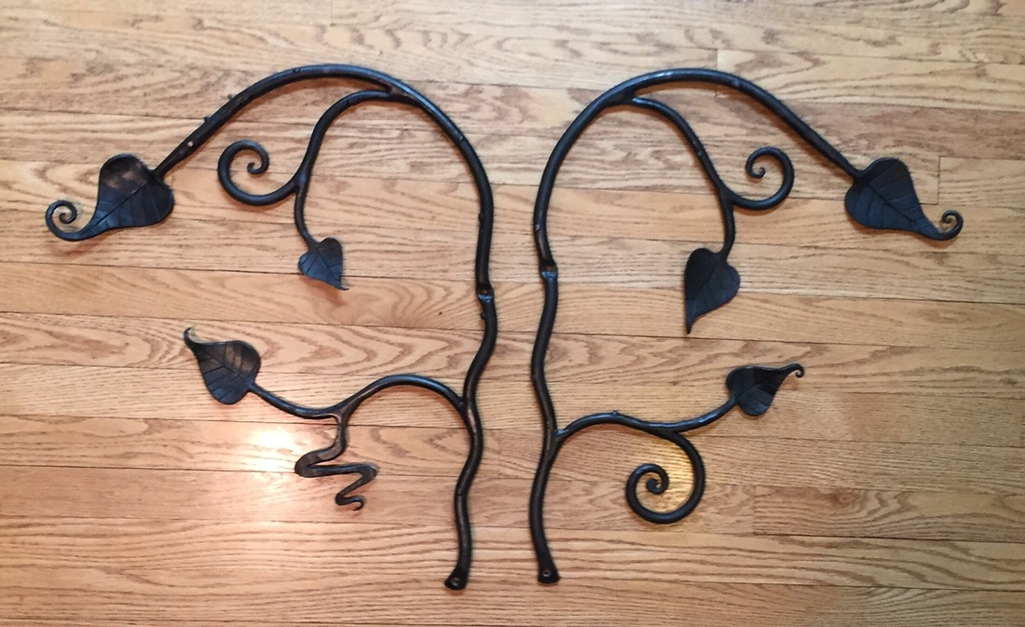

Slide 42
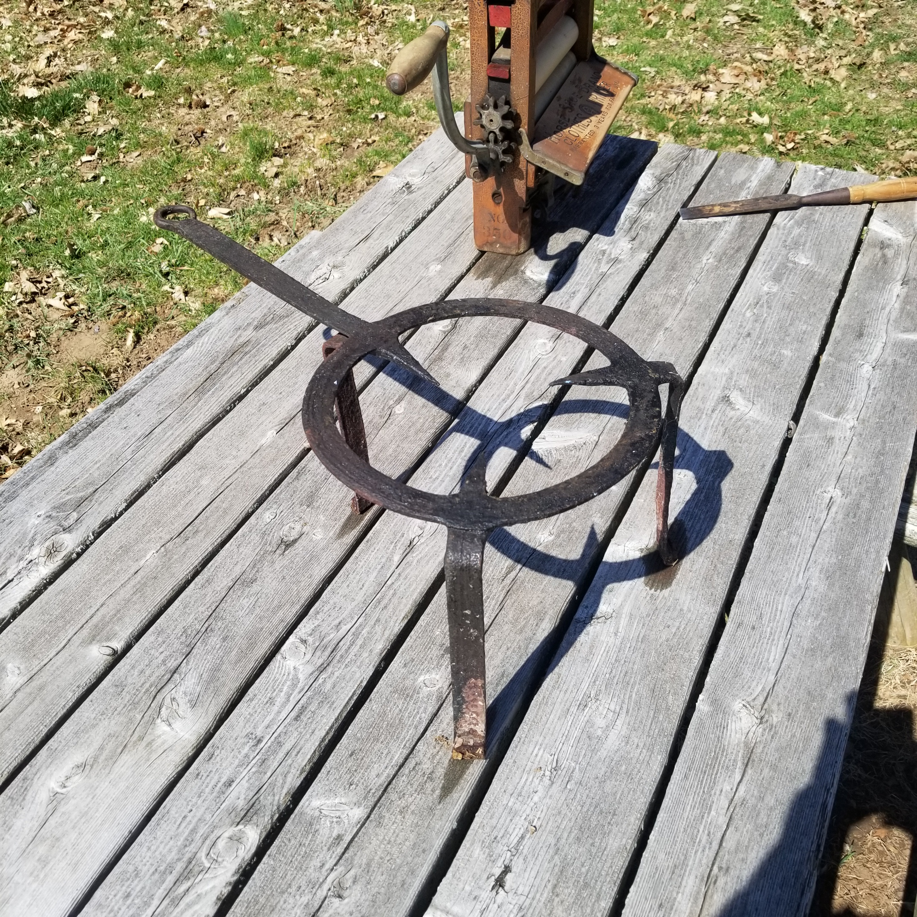
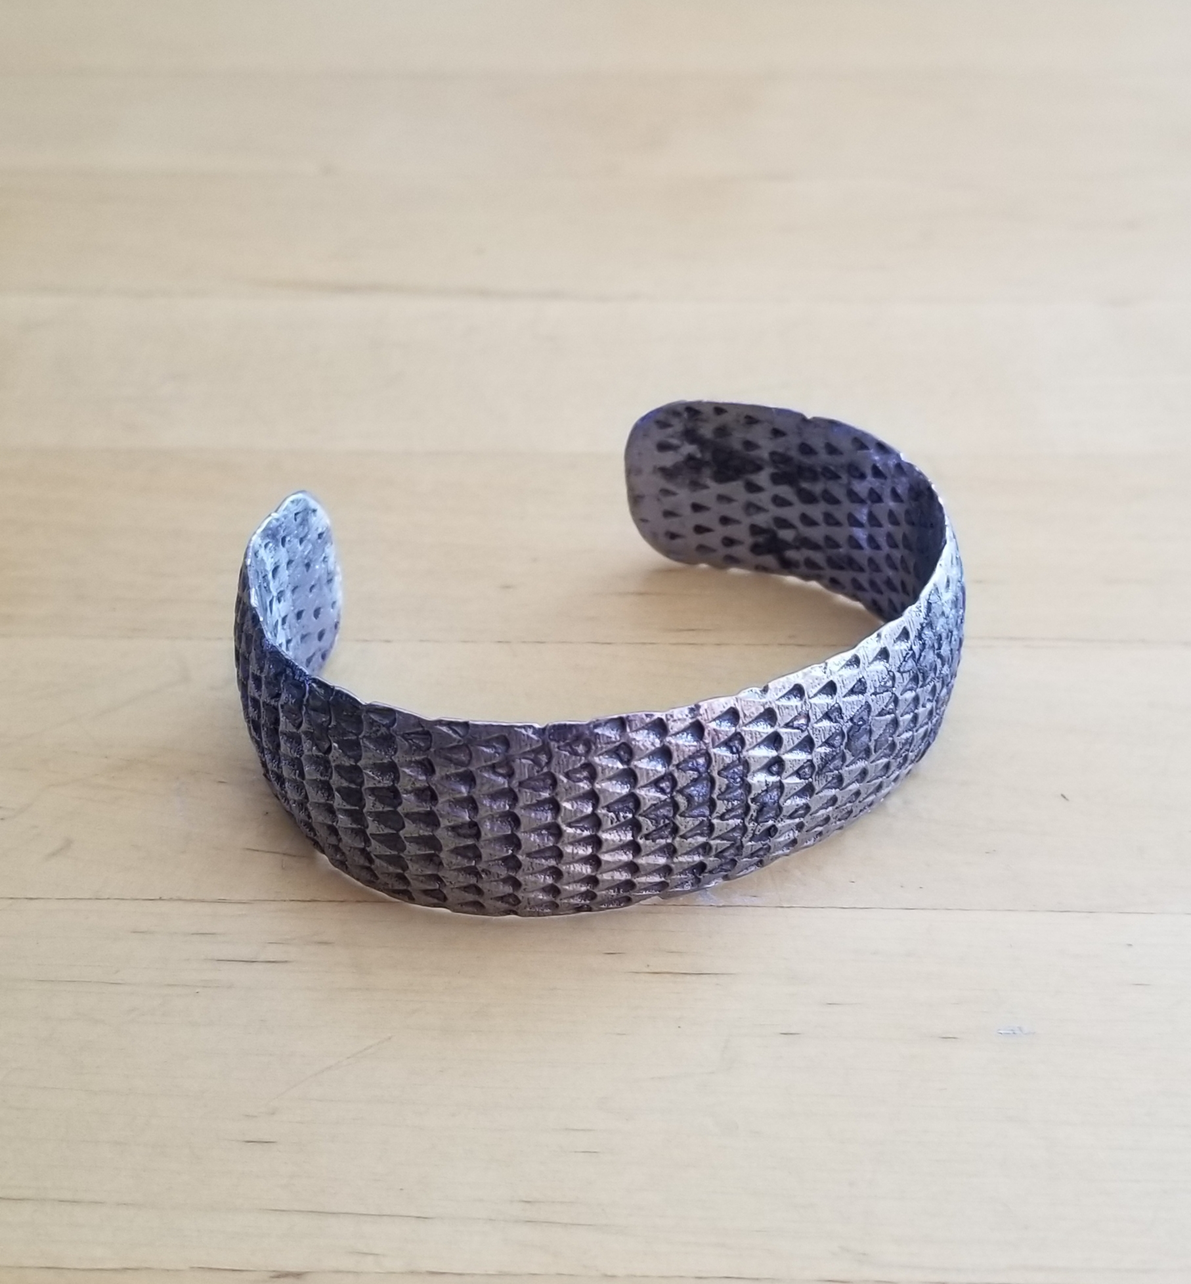
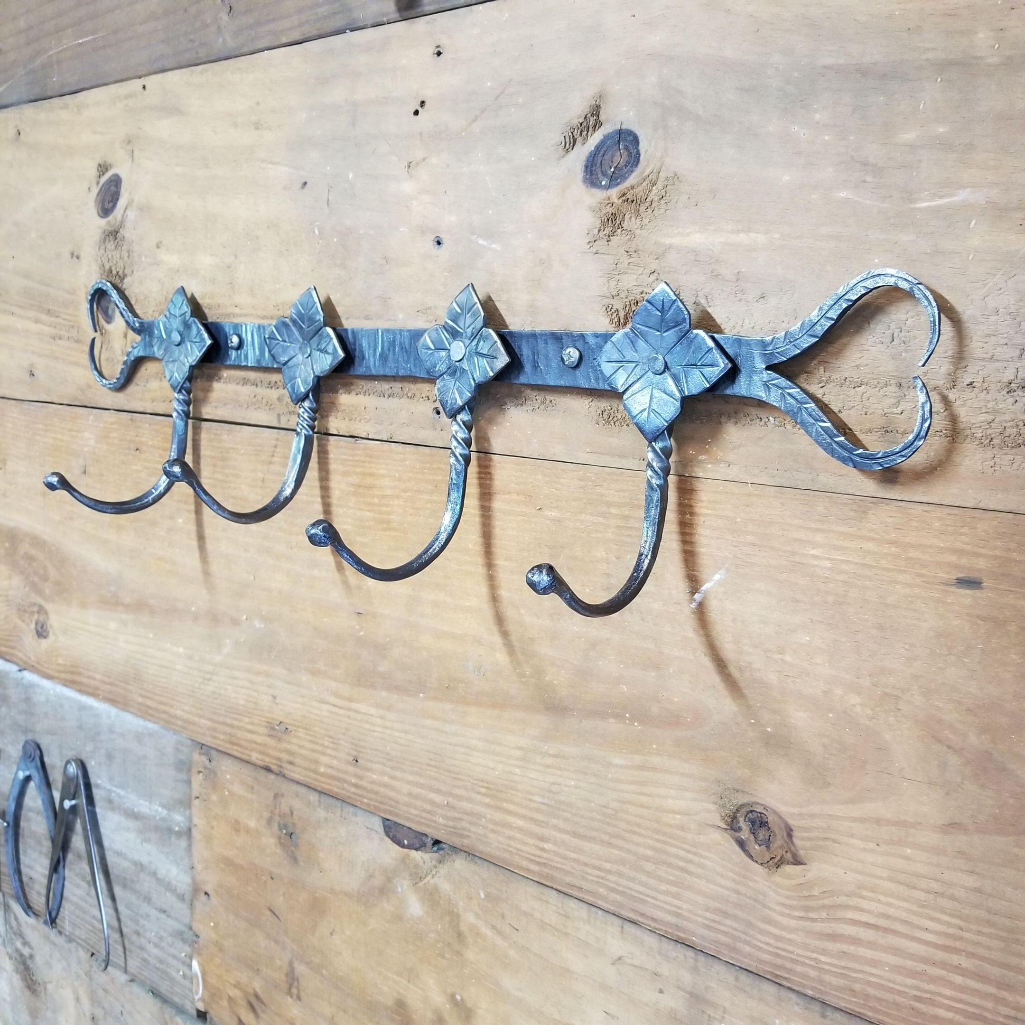
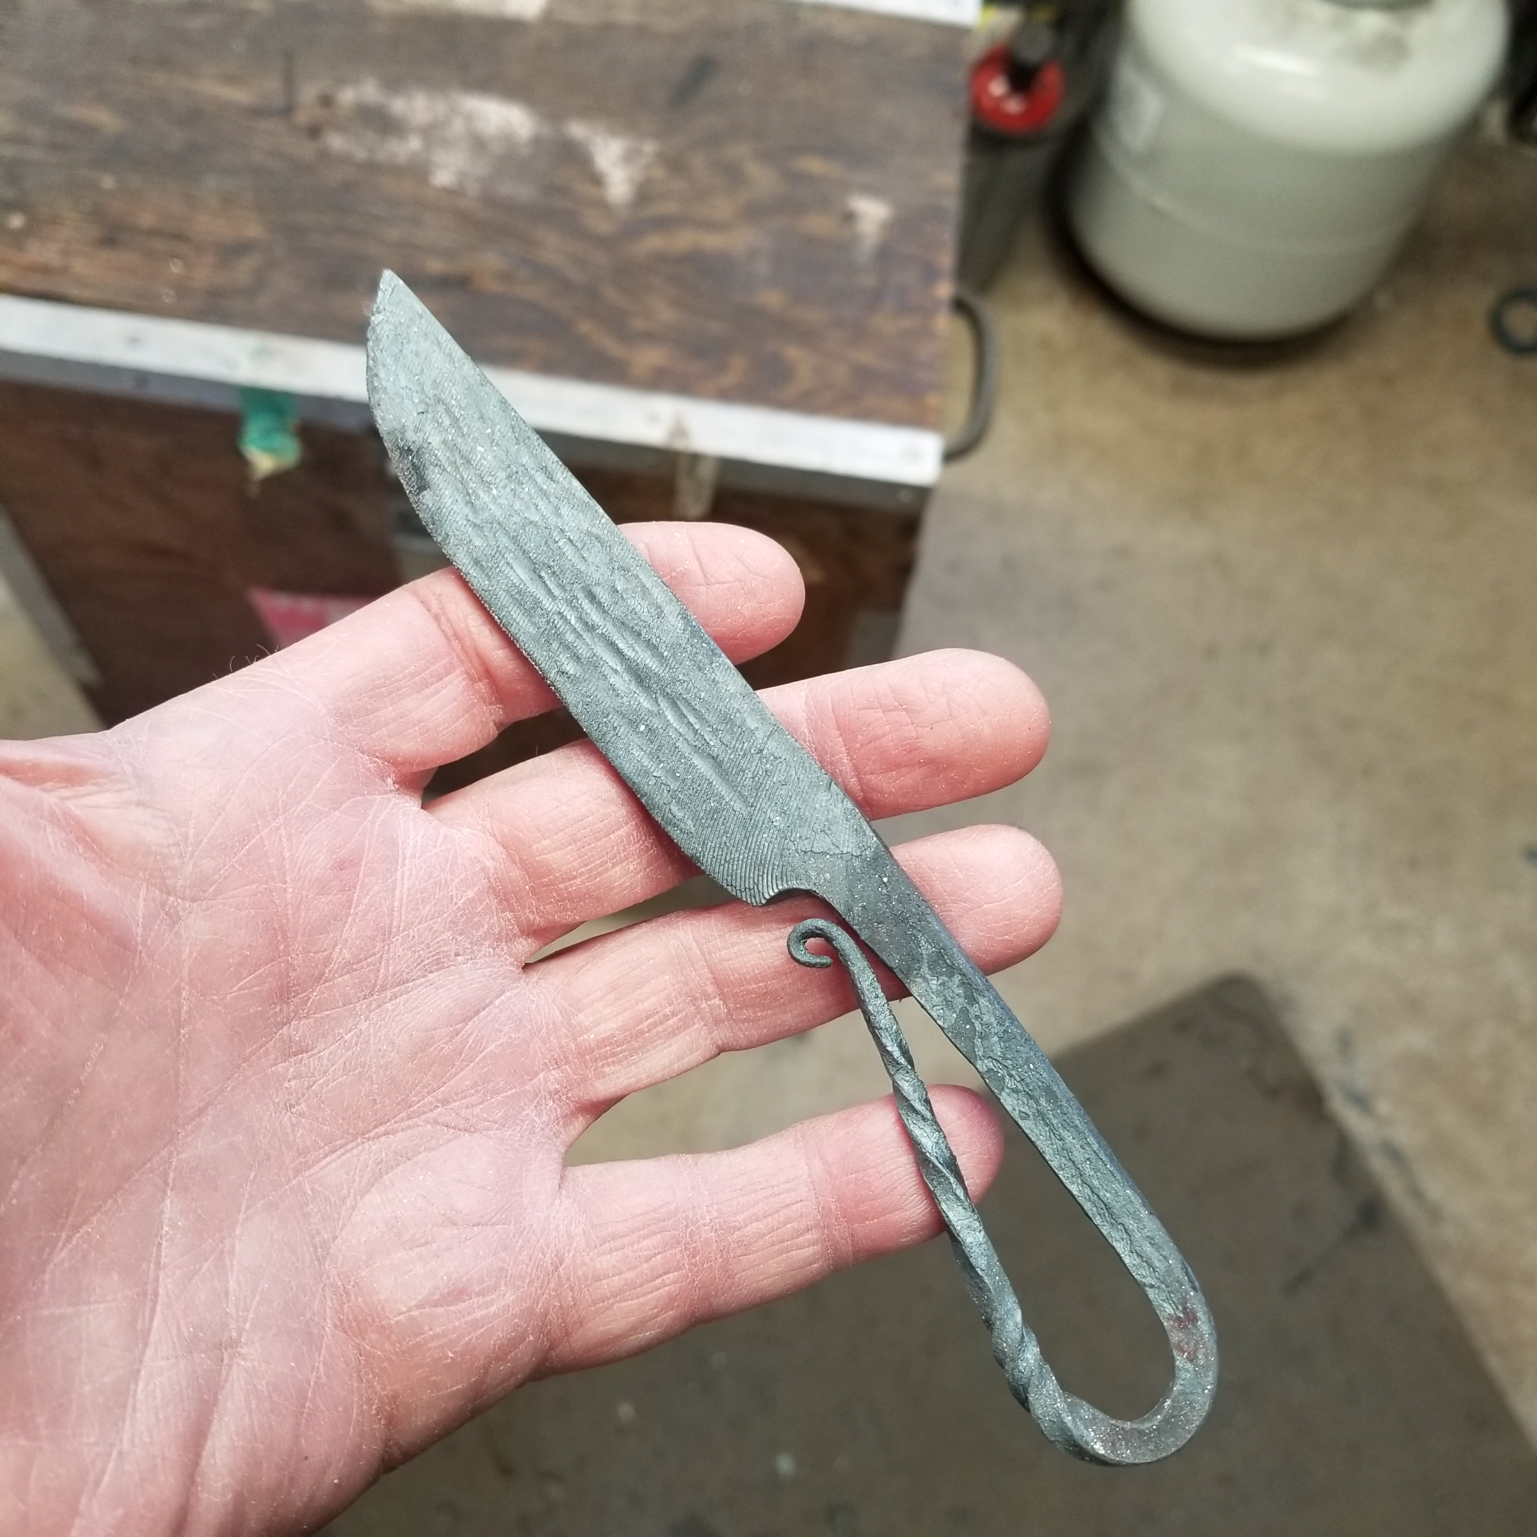

Slide 43
Future ?
Metamorphic manufacturing aka robotic blacksmithing

Slide 44
Questions? THANK YOU!

